Slide 1

Reconocimiento de Patrones
Domingo Mery
Departmento de Ciencia de la Computación
Escuela de Ingeniería
Universidad Católica de Chile
Deep Learning
[ Capítulo 4 ]

Slide 2
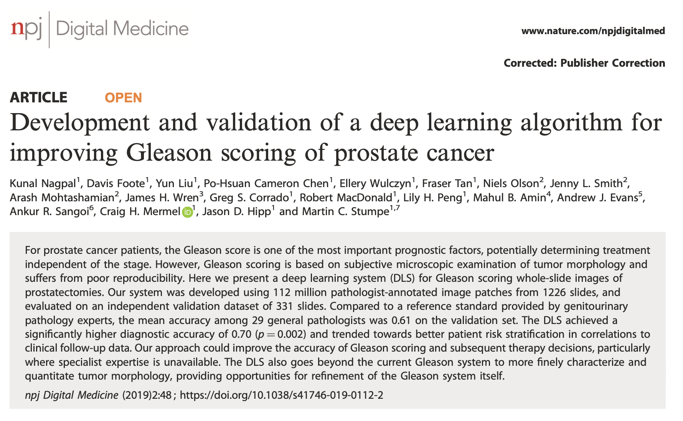
Diagnosis of Prostate Cancer
https://www.nature.com/articles/s41746-019-0112-2.pdf
PAT04_DeepLearning.pptx

Slide 3
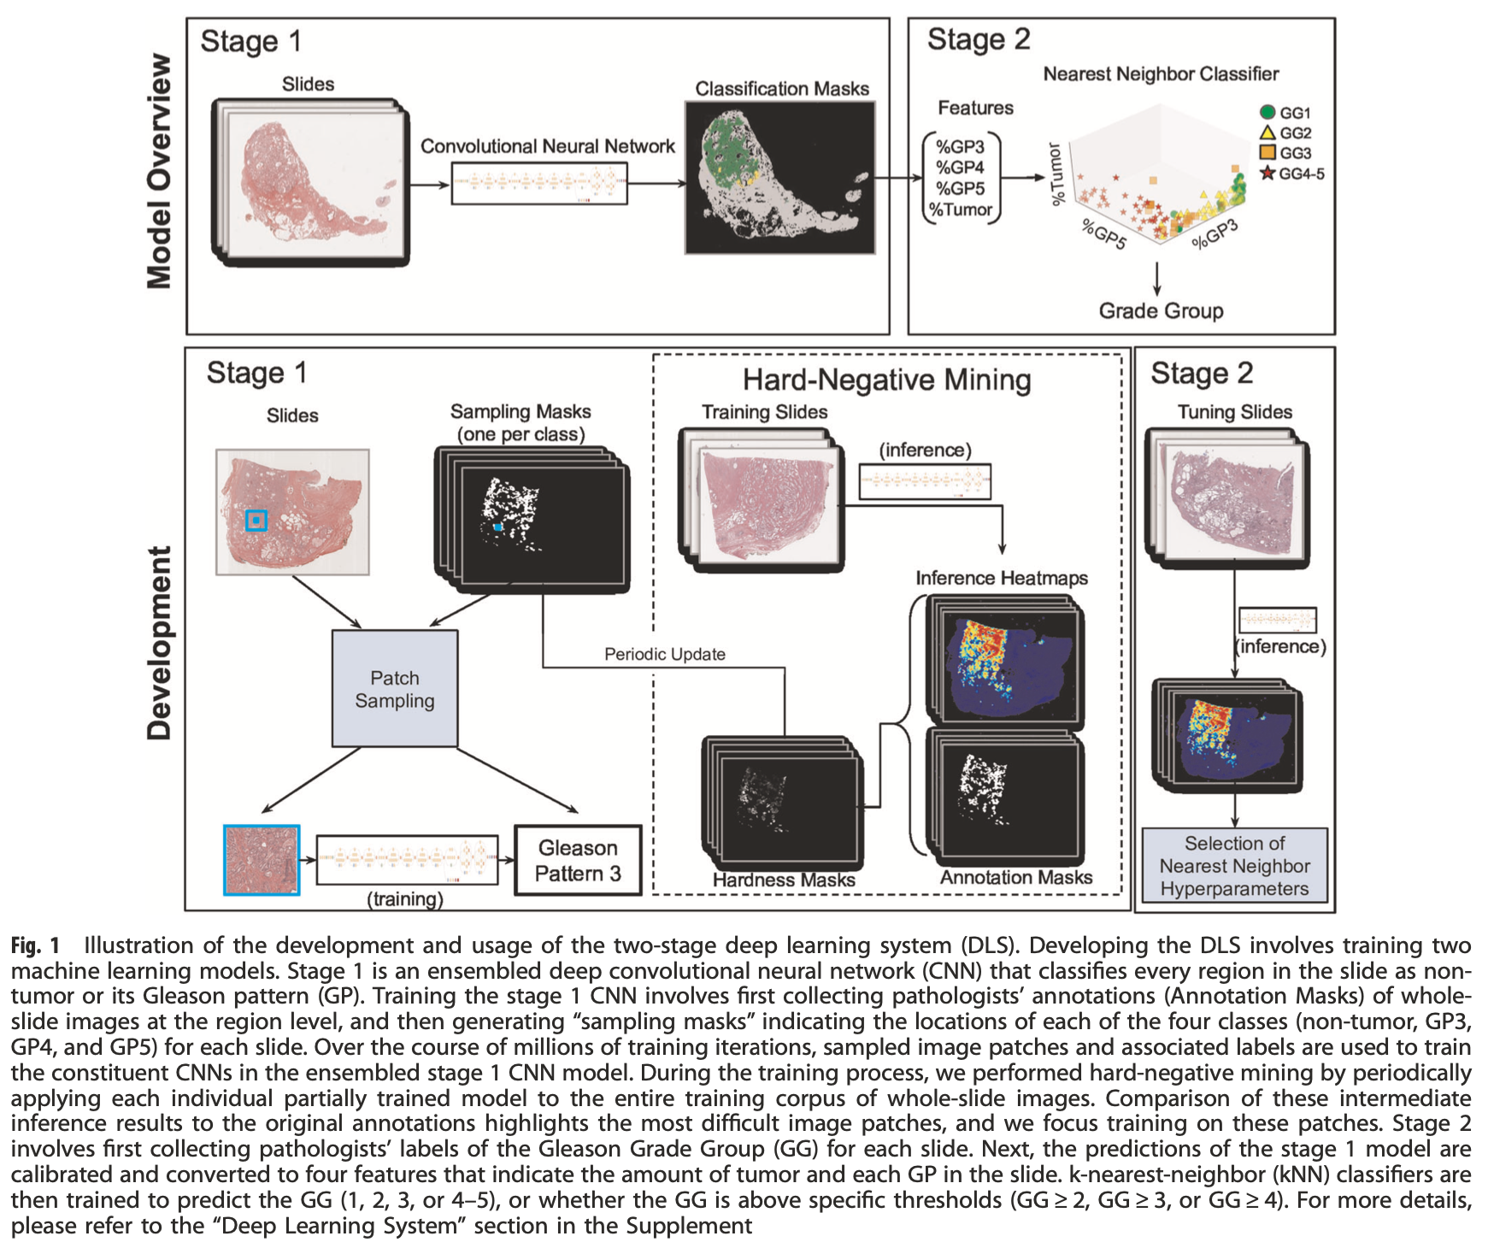
Diagnosis of Prostate Cancer
PAT04_DeepLearning.pptx

Slide 4
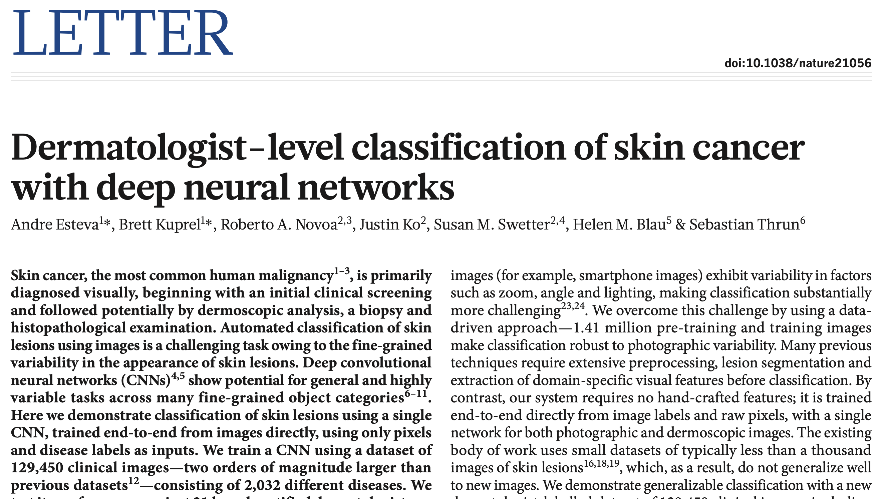
Skin Cancer Recognition
https://www.nature.com/articles/nature21056.pdf
PAT04_DeepLearning.pptx

Slide 5
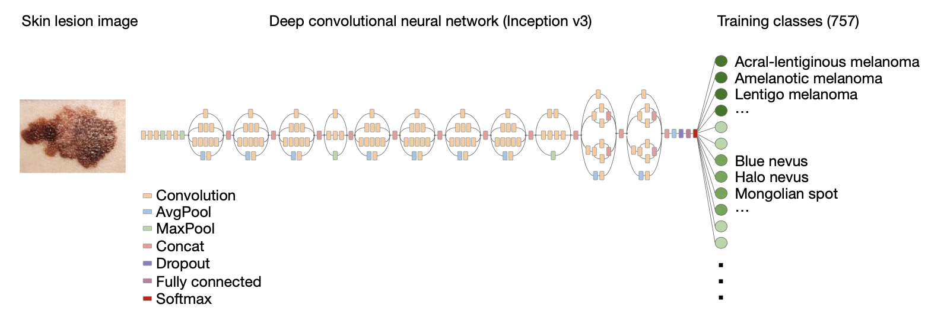
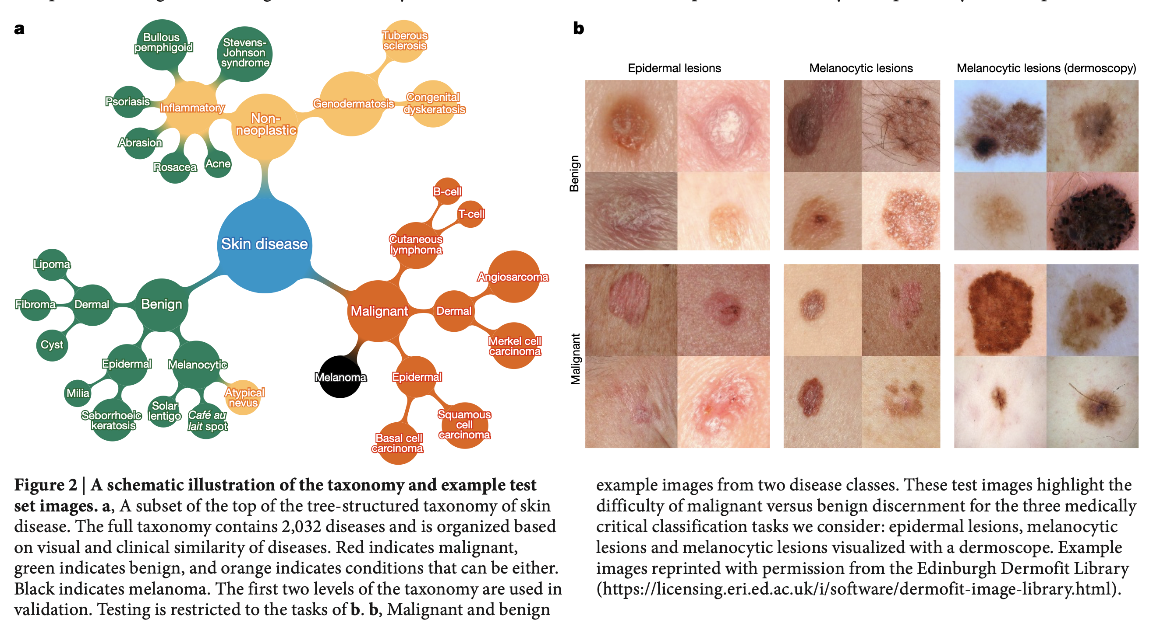
Skin Cancer Recognition
PAT04_DeepLearning.pptx

Slide 6
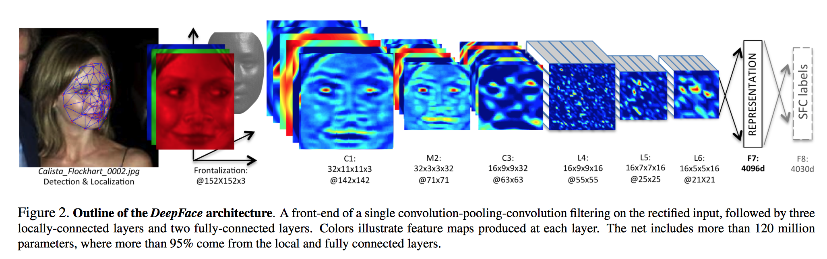
Face Recognition
Taigman, Yaniv, et al. "Deepface: Closing the gap to human-level performance in face verification." Proceedings of the IEEE Conference on Computer Vision and Pattern Recognition. 2014. [ PDF ]
PAT04_DeepLearning.pptx

Slide 7
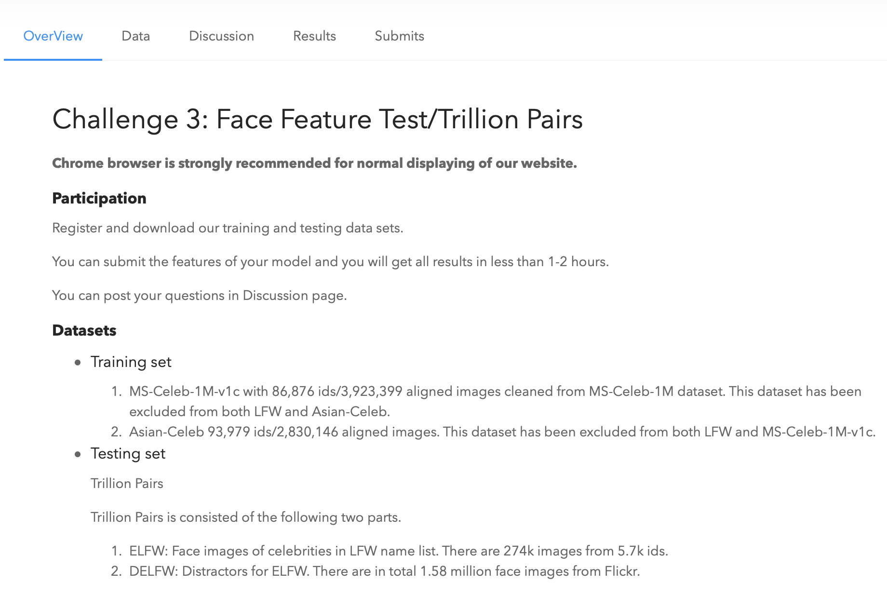
Face Recognition
http://trillionpairs.deepglint.com
PAT04_DeepLearning.pptx

Slide 8
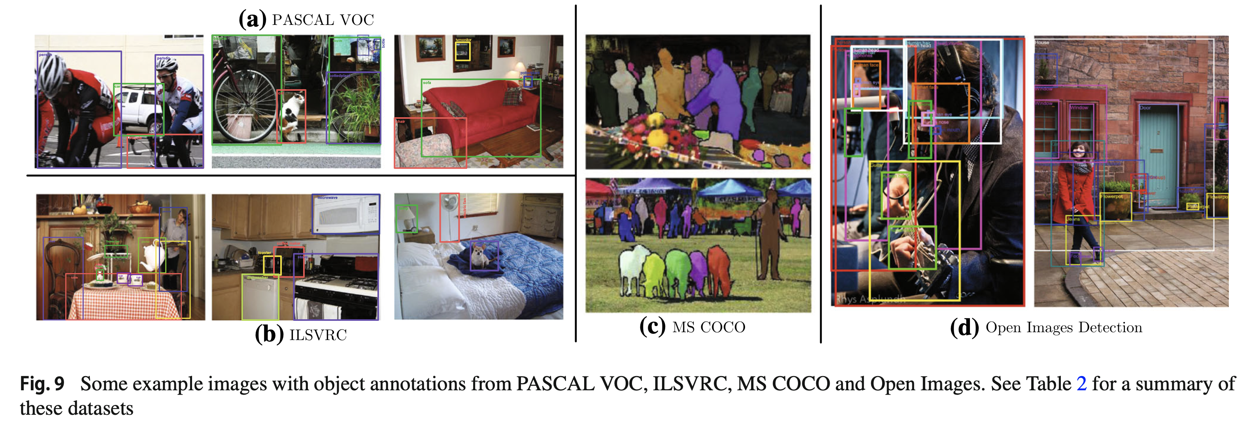
Object Detection
Liu, L., Ouyang, W., Wang, X., Fieguth, P., Chen, J., Liu, X., & Pietikäinen, M. (2020). Deep learning for generic object detection: A survey. International journal of computer vision, 128(2), 261-318.
PAT04_DeepLearning.pptx

Slide 9
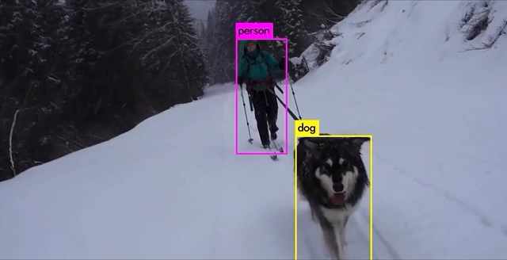
Object Detection
https://pjreddie.com/darknet/yolo/
PAT04_DeepLearning.pptx

Slide 10
Motivation
PAT04_DeepLearning.pptx

Slide 11
Images of different
known classes
Representation
Class 1
Feature Feature Design of
Extraction Selection Classifier
Class 2
Class n
Stage 1: TRAINING
Stage 2: TESTING
Extraction of
selected
features
InputA: Test Image
Class
Classification
Output:
PAT04_DeepLearning.pptx

Slide 12
MOTIVATION
Handcrafted vs. Learned features
LBP, Haralick, Fourier, Gabor, etc.
or
Learned representation from training data
PAT04_DeepLearning.pptx

Slide 13
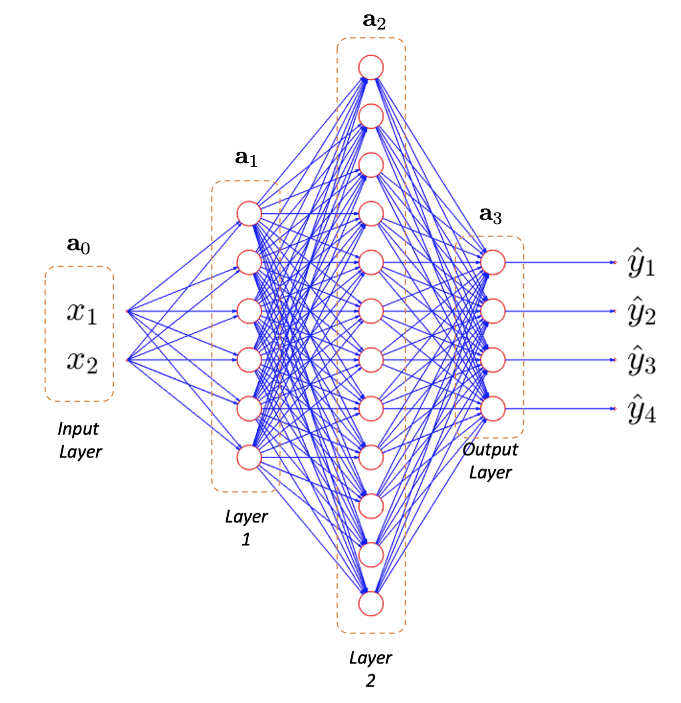
MOTIVATION
Neural networks
PAT04_DeepLearning.pptx

Slide 14
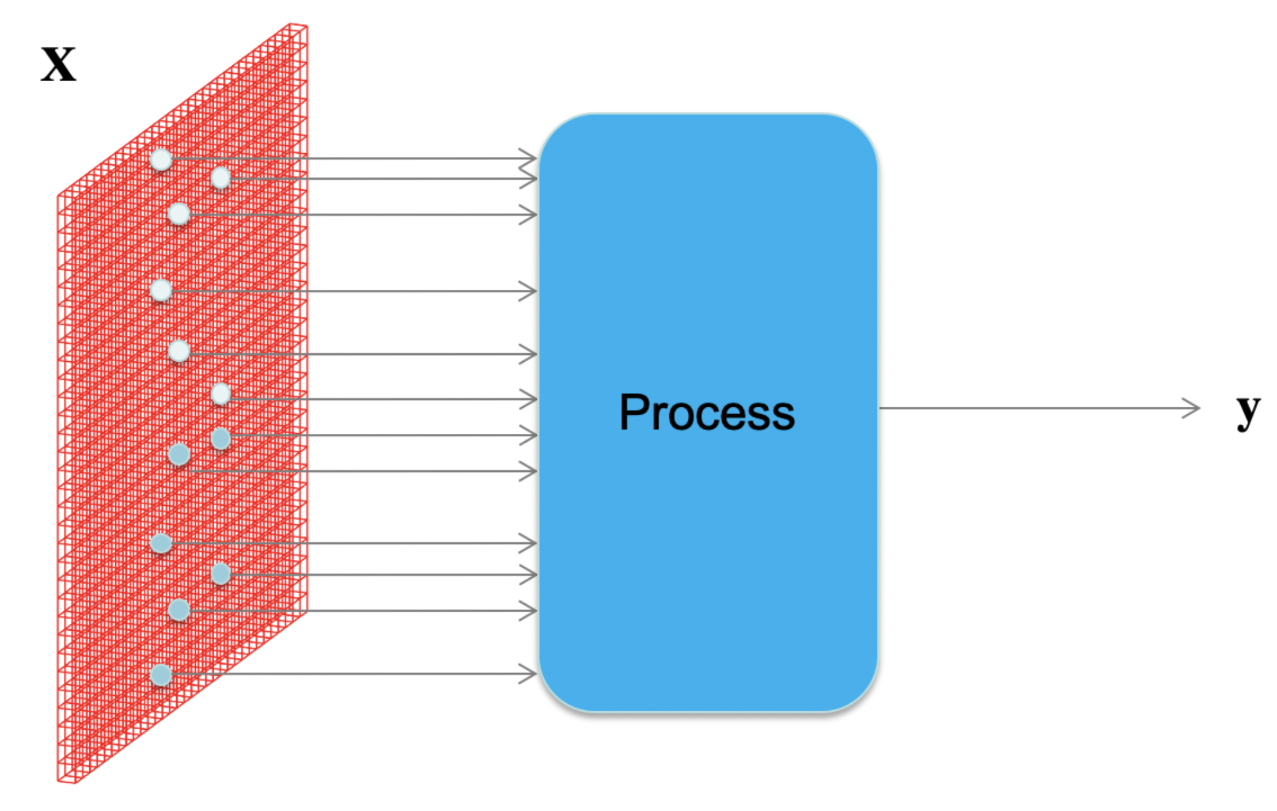
MOTIVATION
How to process an image with neural networks?
PAT04_DeepLearning.pptx

Slide 15
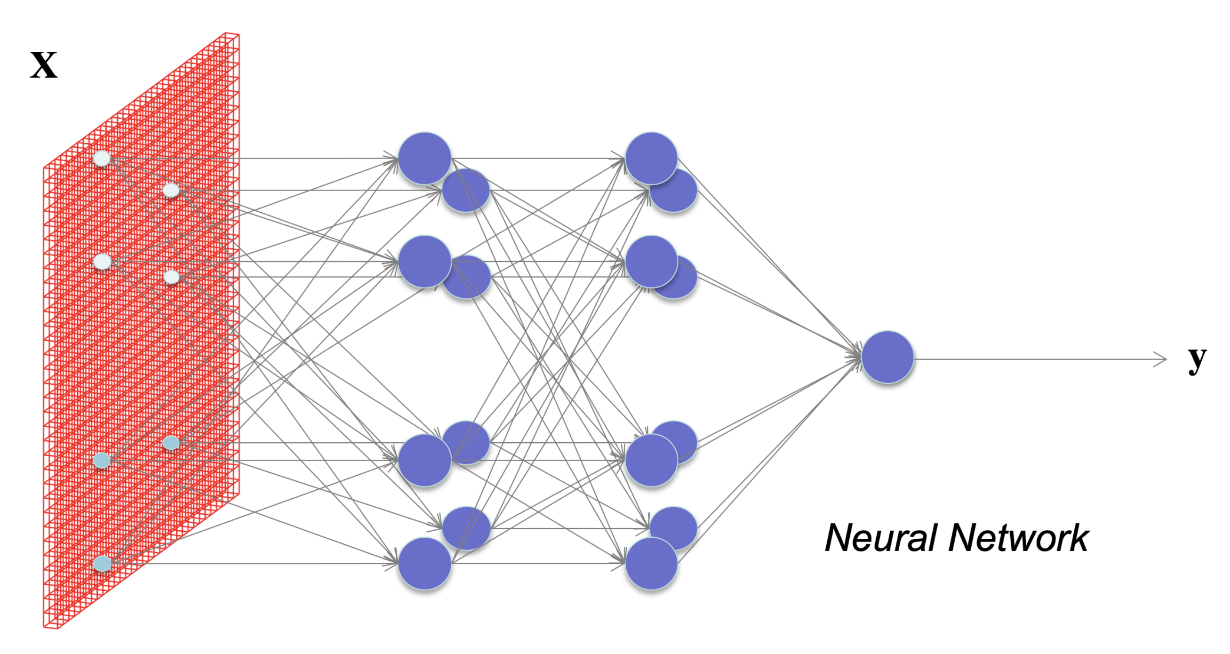

MOTIVATION
What happens if each pixel is an input?
How many neurons and weights?
PAT04_DeepLearning.pptx

Slide 16
Basics
PAT04_DeepLearning.pptx

Slide 17
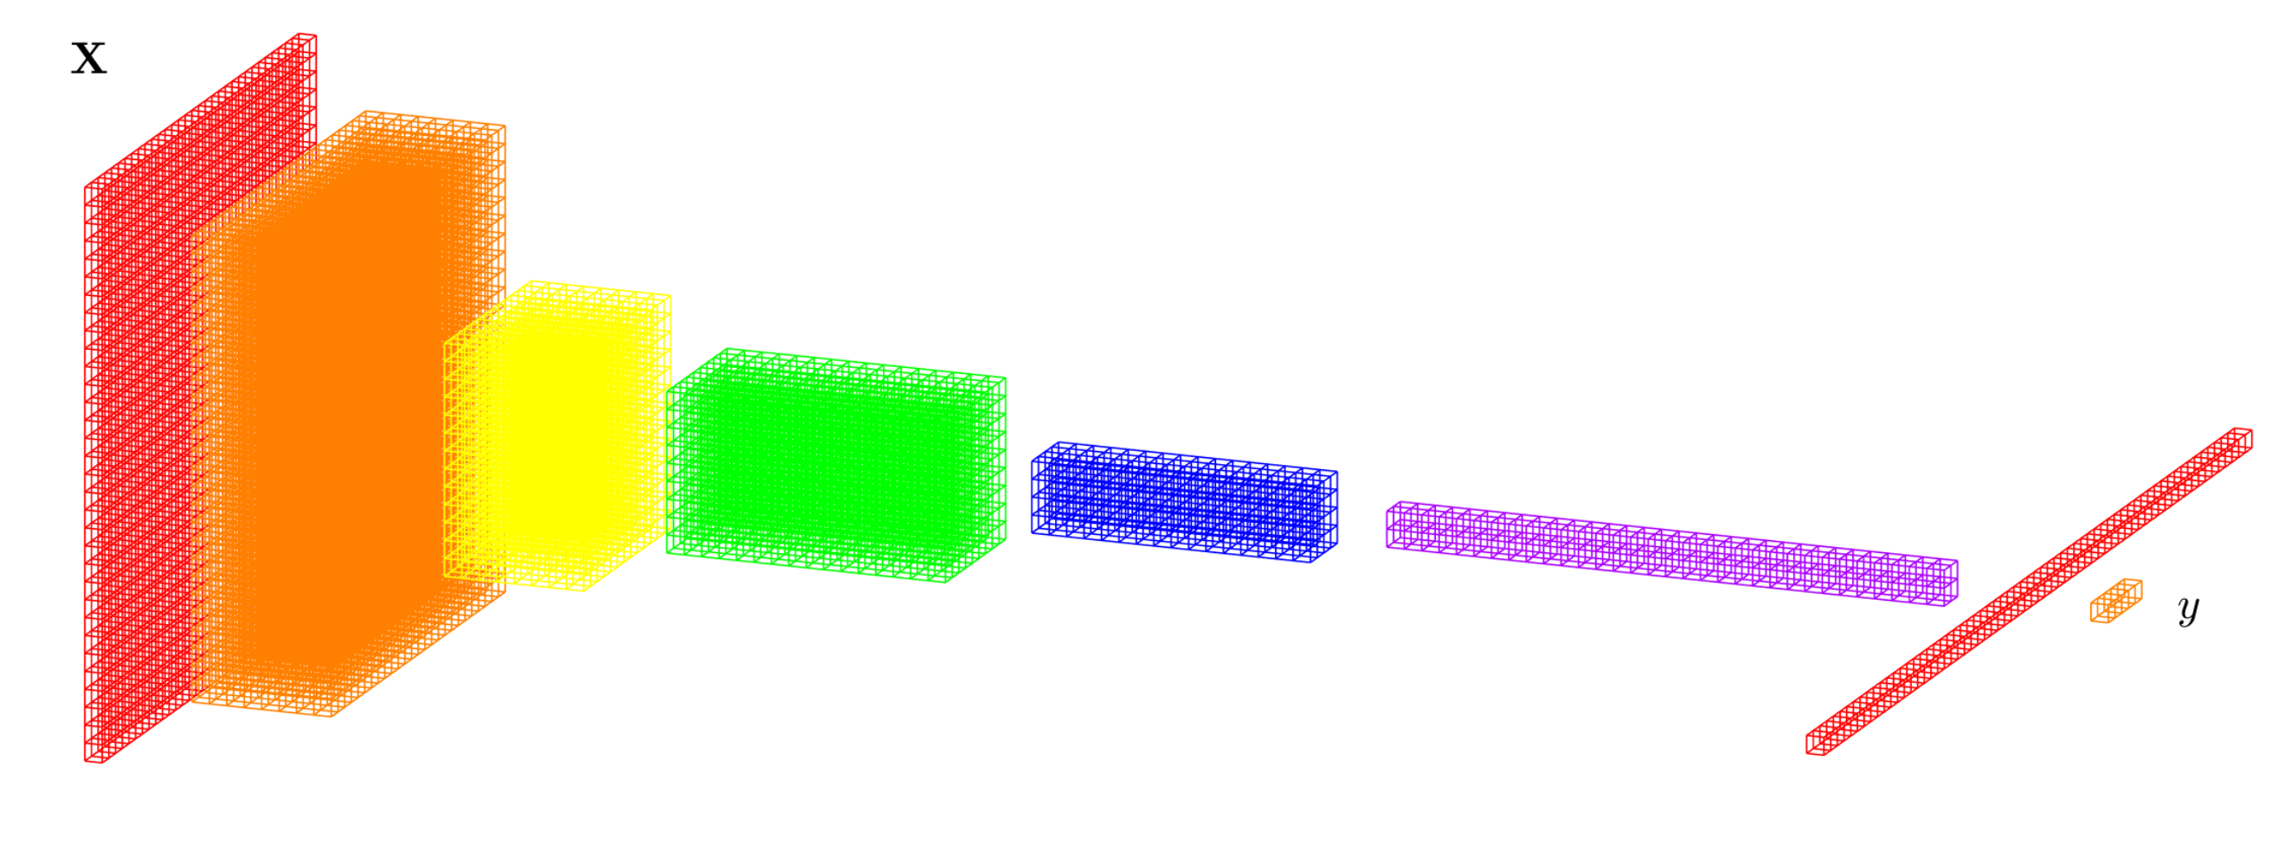
DEEP LEARNING BASICS (CNN)
Convolutional Neural Networks)
Data
representation
Input
image
Layers
Classification
PAT04_DeepLearning.pptx

Slide 18
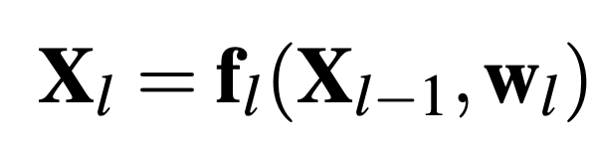
DEEP LEARNING BASICS (CNN)
Convolutional Neural Networks)
f₁
f₂
f₃
f₄
f₅
f₇
f₆
Input
image
Layers
Classification
PAT04_DeepLearning.pptx

Slide 19
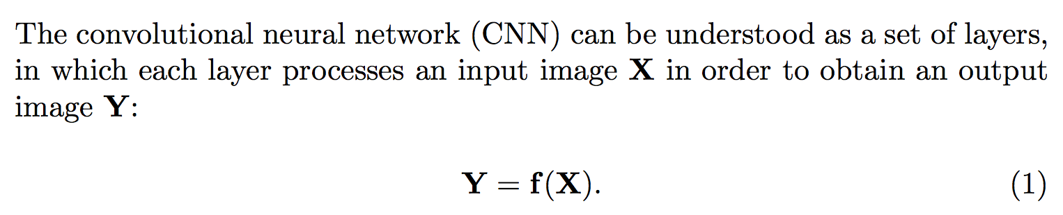
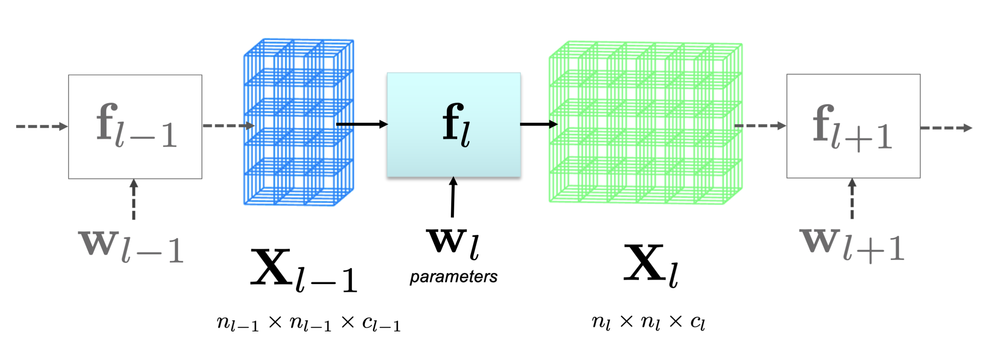
DEEP LEARNING BASICS
PAT04_DeepLearning.pptx

Slide 20
DEEP LEARNING: Typical layers
Convolution layer
Pooling layer
Rectified Linear Unit
Fully connected and SoftMax
PAT04_DeepLearning.pptx

Slide 21
DEEP LEARNING: Typical layers
Convolution layer
Pooling layer
Rectified Linear Unit
Fully connected and SoftMax
PAT04_DeepLearning.pptx

Slide 22
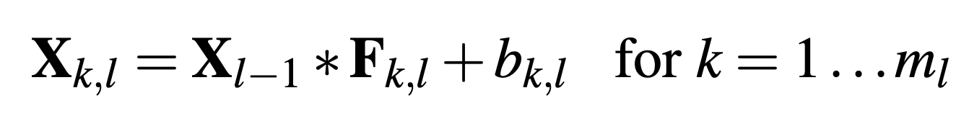
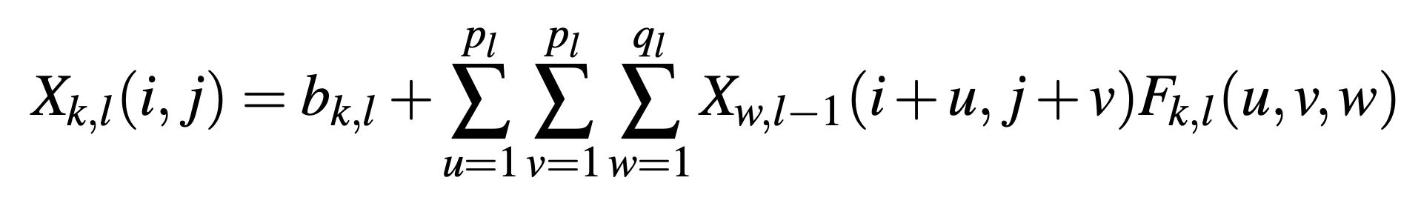
DEEP LEARNING: Convolution layer
PAT04_DeepLearning.pptx

Slide 23
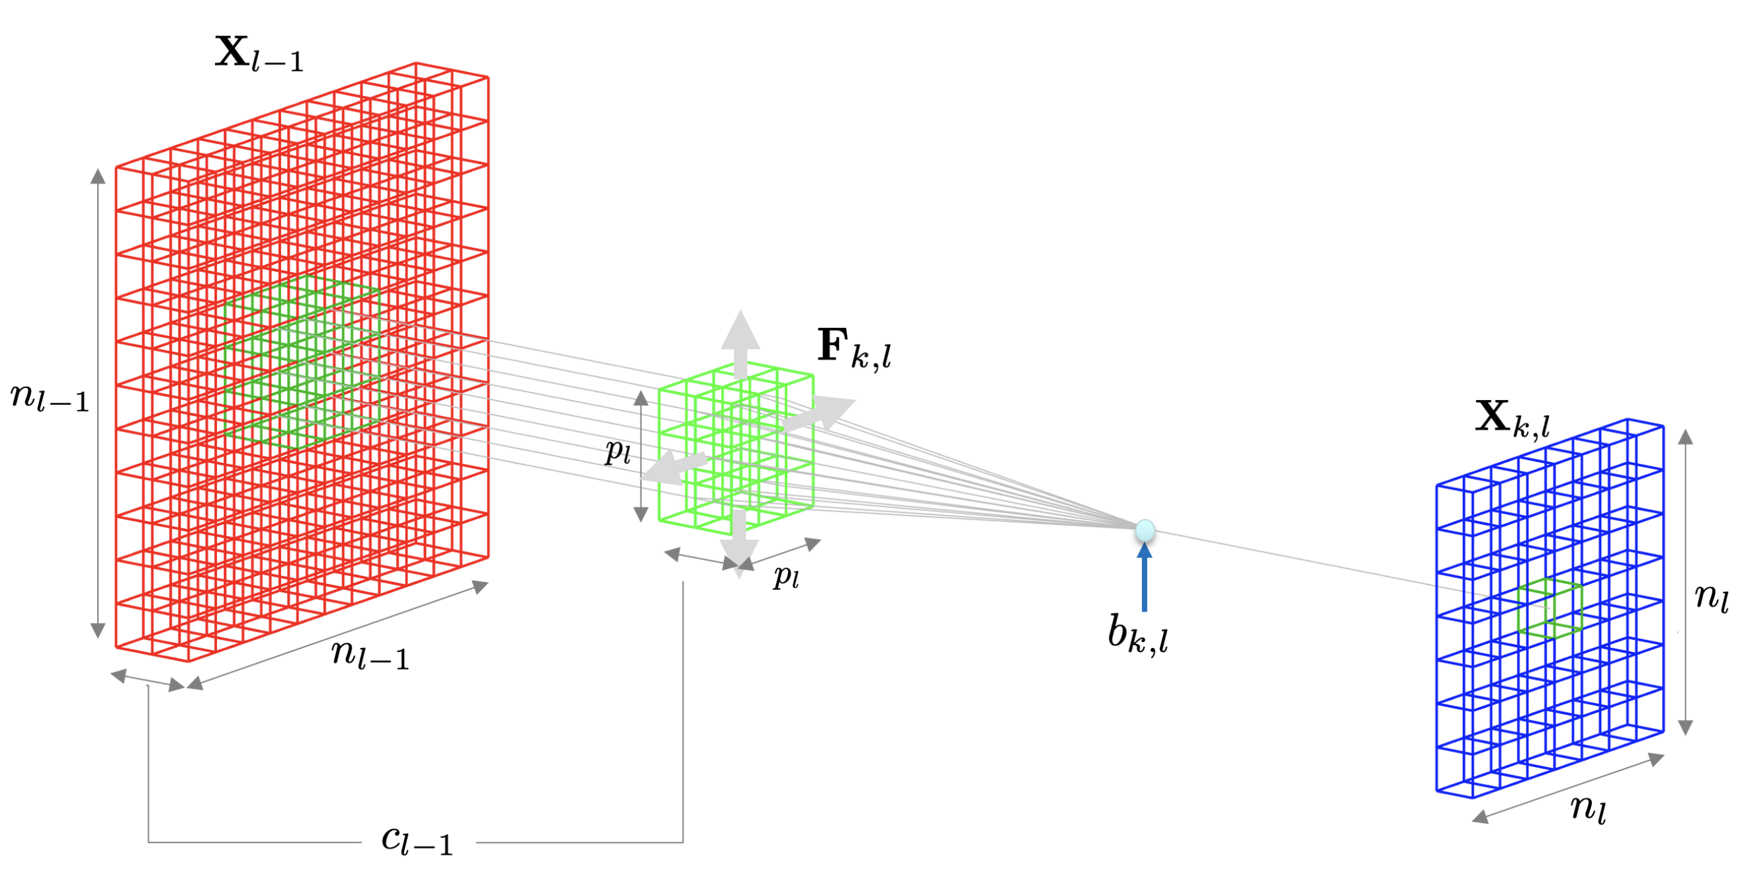
DEEP LEARNING: Convolution layer
PAT04_DeepLearning.pptx

Slide 24
DEEP LEARNING: Typical layers
Convolution layer
Pooling layer
Rectified Linear Unit
Fully connected and SoftMax
PAT04_DeepLearning.pptx

Slide 25
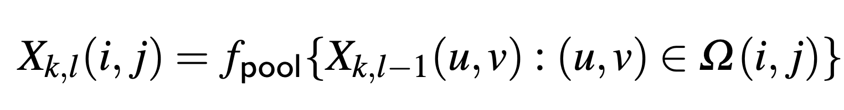
DEEP LEARNING: Pooling layer
PAT04_DeepLearning.pptx

Slide 26
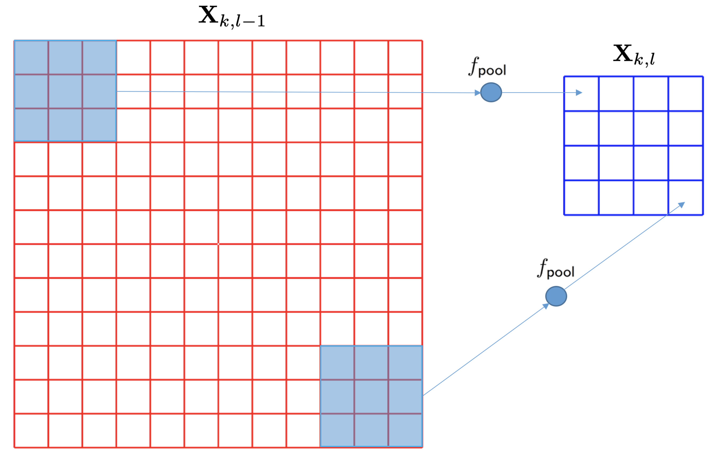
DEEP LEARNING: Pooling layer
PAT04_DeepLearning.pptx

Slide 27
DEEP LEARNING: Typical layers
Convolution layer
Pooling layer
Rectified Linear Unit
Fully connected and SoftMax
PAT04_DeepLearning.pptx

Slide 28
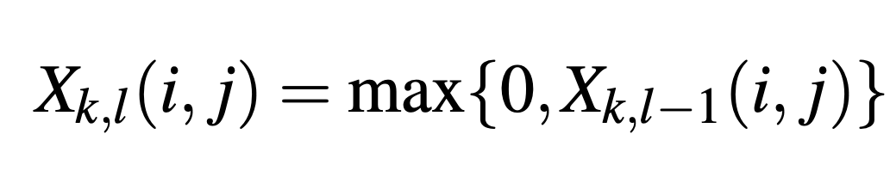
DEEP LEARNING: Rectified Linear Unit (ReLU)
PAT04_DeepLearning.pptx

Slide 29
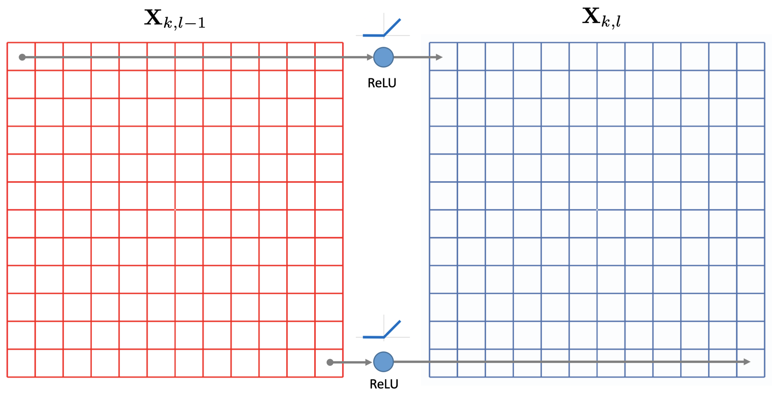
DEEP LEARNING: Rectified Linear Unit (ReLU)
PAT04_DeepLearning.pptx

Slide 30
DEEP LEARNING: Typical layers
Convolution layer
Pooling layer
Rectified Linear Unit
Fully connected and SoftMax
PAT04_DeepLearning.pptx

Slide 31
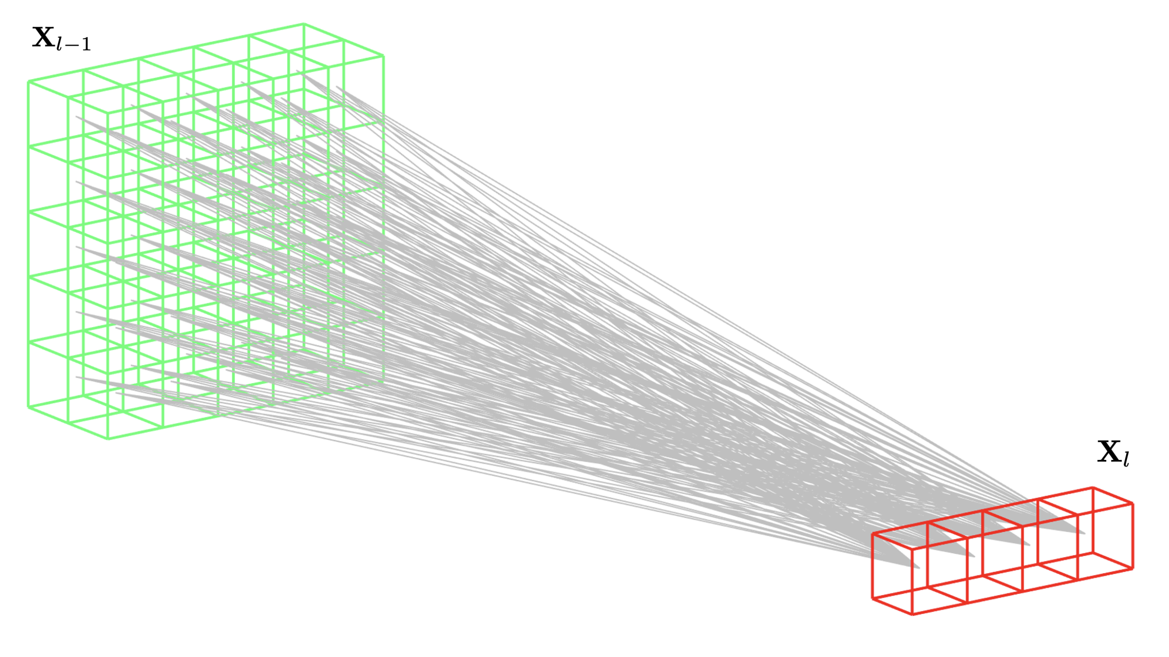
DEEP LEARNING: Fully Connected
PAT04_DeepLearning.pptx

Slide 32
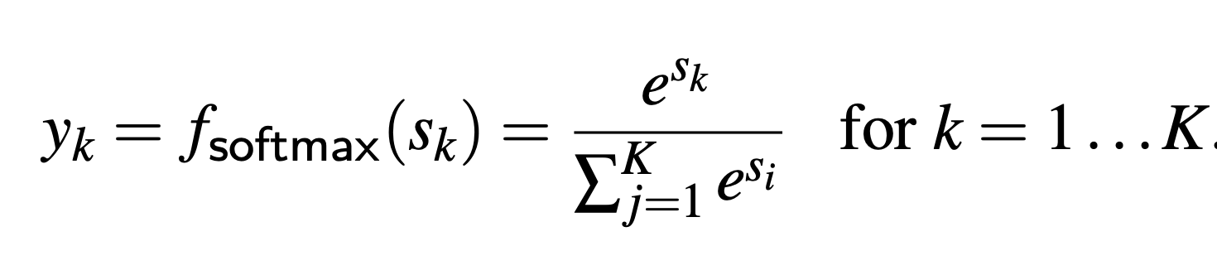
DEEP LEARNING: Fully Connected + SoftMax
PAT04_DeepLearning.pptx

Slide 33
Training
PAT04_DeepLearning.pptx

Slide 34
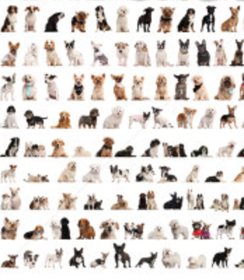


DEEP LEARNING: Training
dogs
errors
cats
Back-propagation
PAT04_DeepLearning.pptx

Slide 35
Example
Eyes vs. Nose Recognizer
PAT04_DeepLearning.pptx

Slide 36
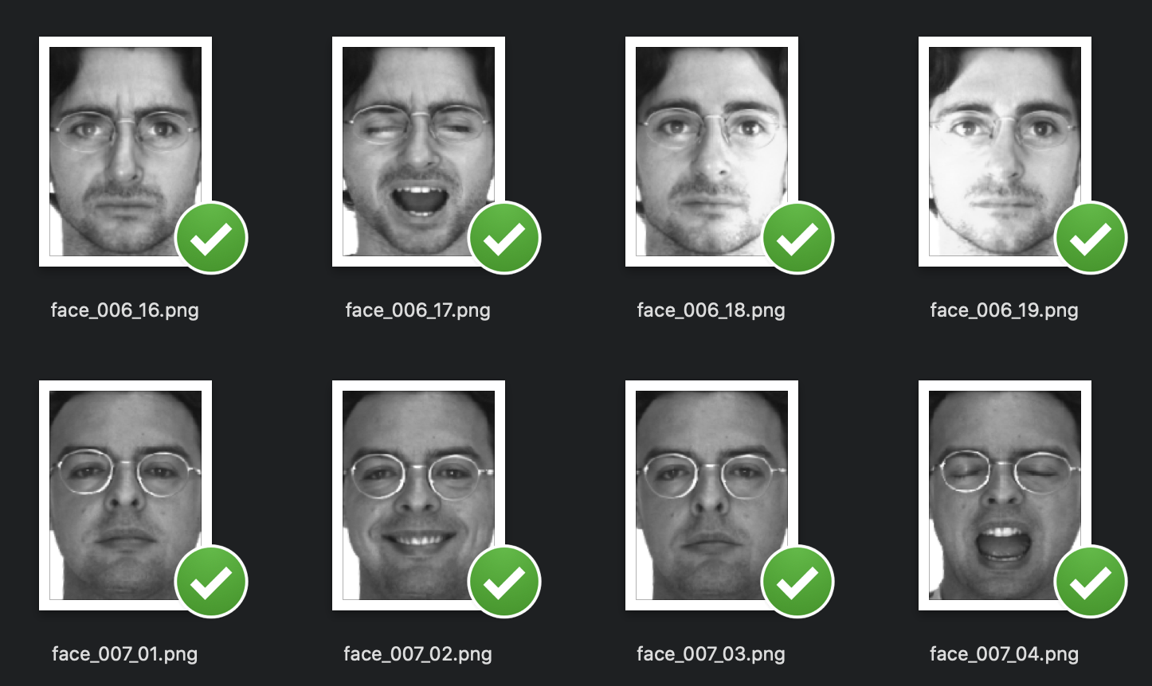
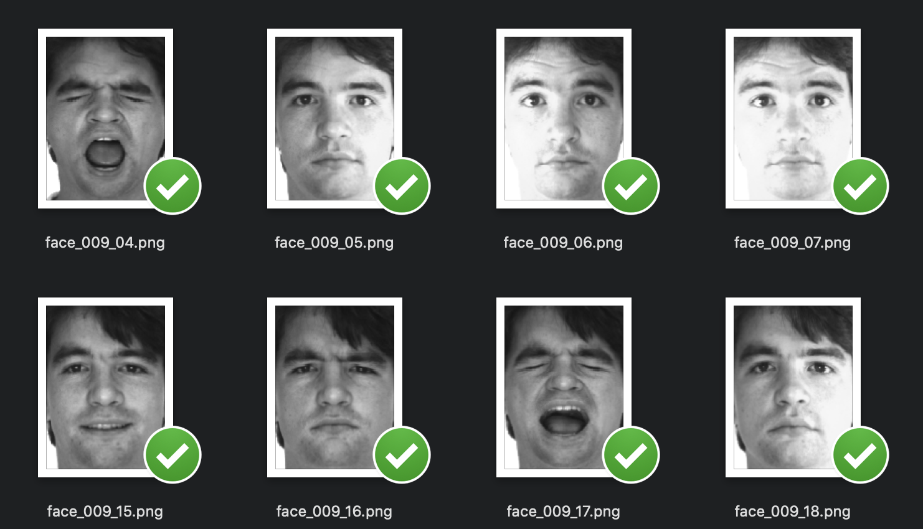
PAT04_DeepLearning.pptx

Slide 37
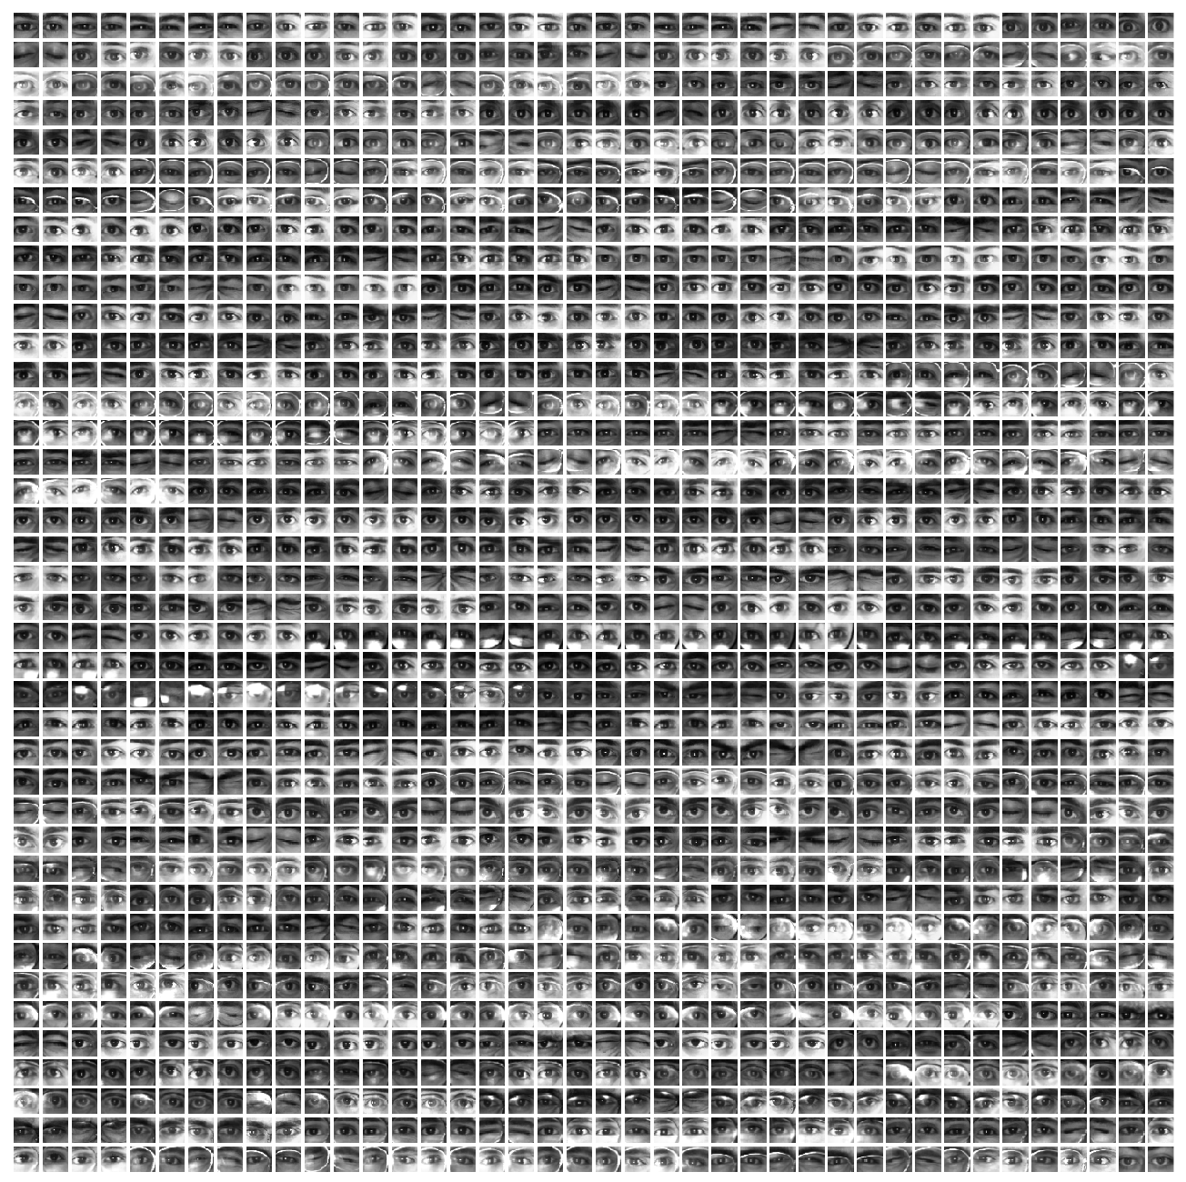
Eyes

Slide 38
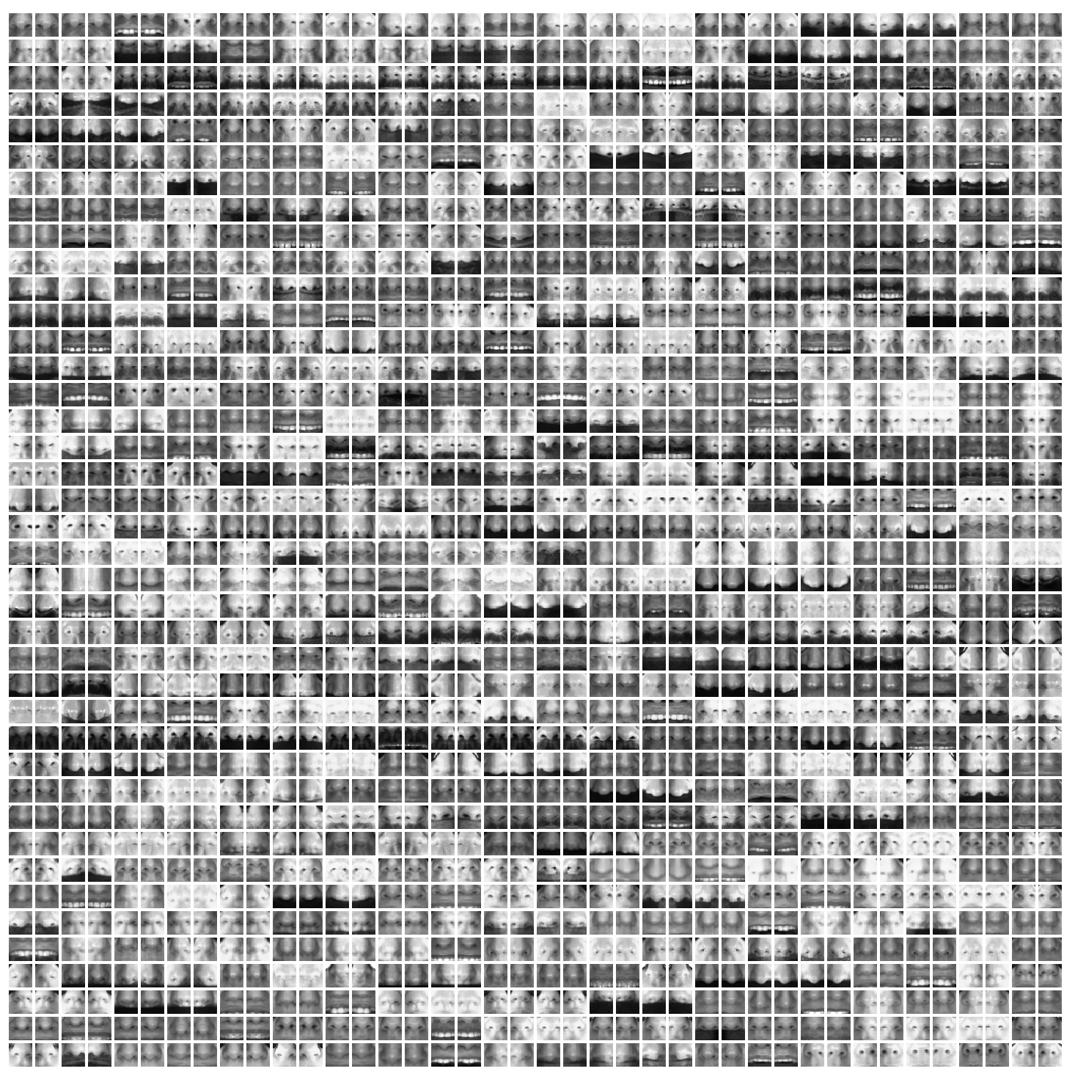
Noses

Slide 39
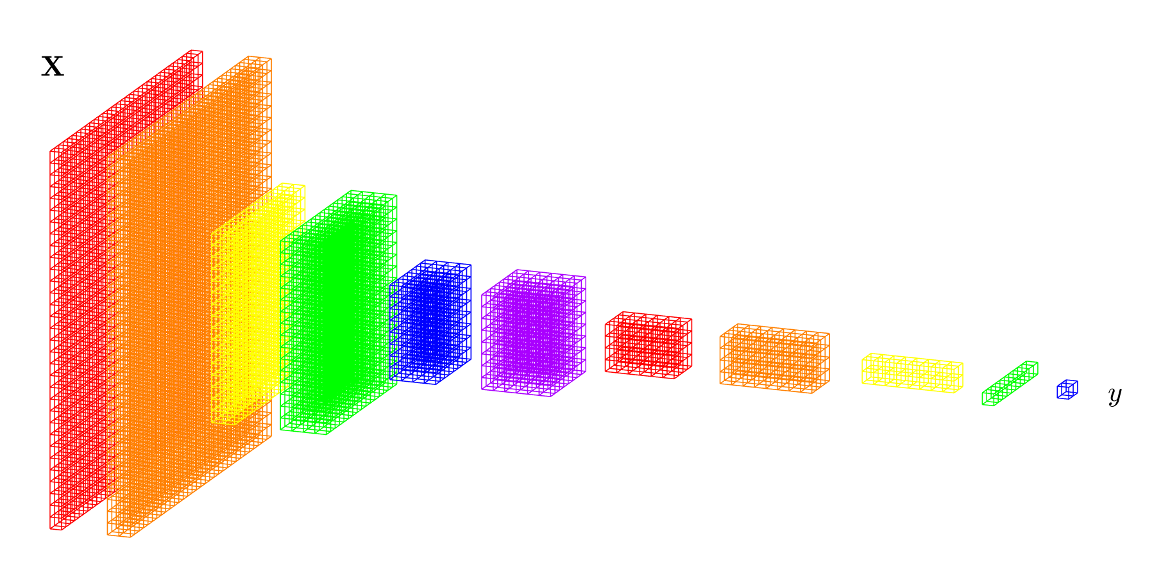
PAT04_DeepLearning.pptx

Slide 40
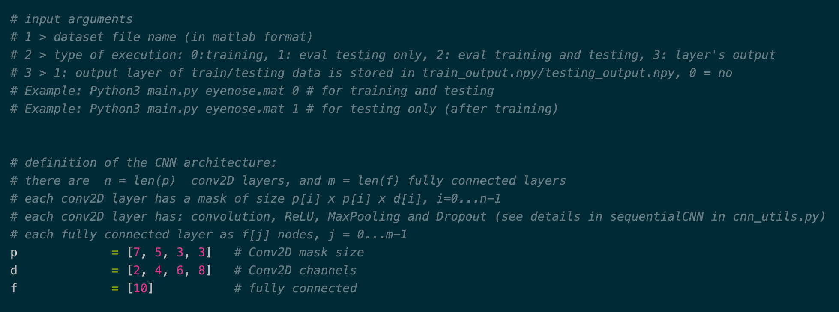
conv2D: 7x7x2 + ReLU + MaxPool + Dropout
5x5x4 + ReLU + MaxPool + Dropout
3x3x6 + ReLU + MaxPool + Dropout
3x3x8 + ReLU + MaxPool + Dropout
fc: 10
+
fc+softmax 2
PAT04_DeepLearning.pptx

Slide 41
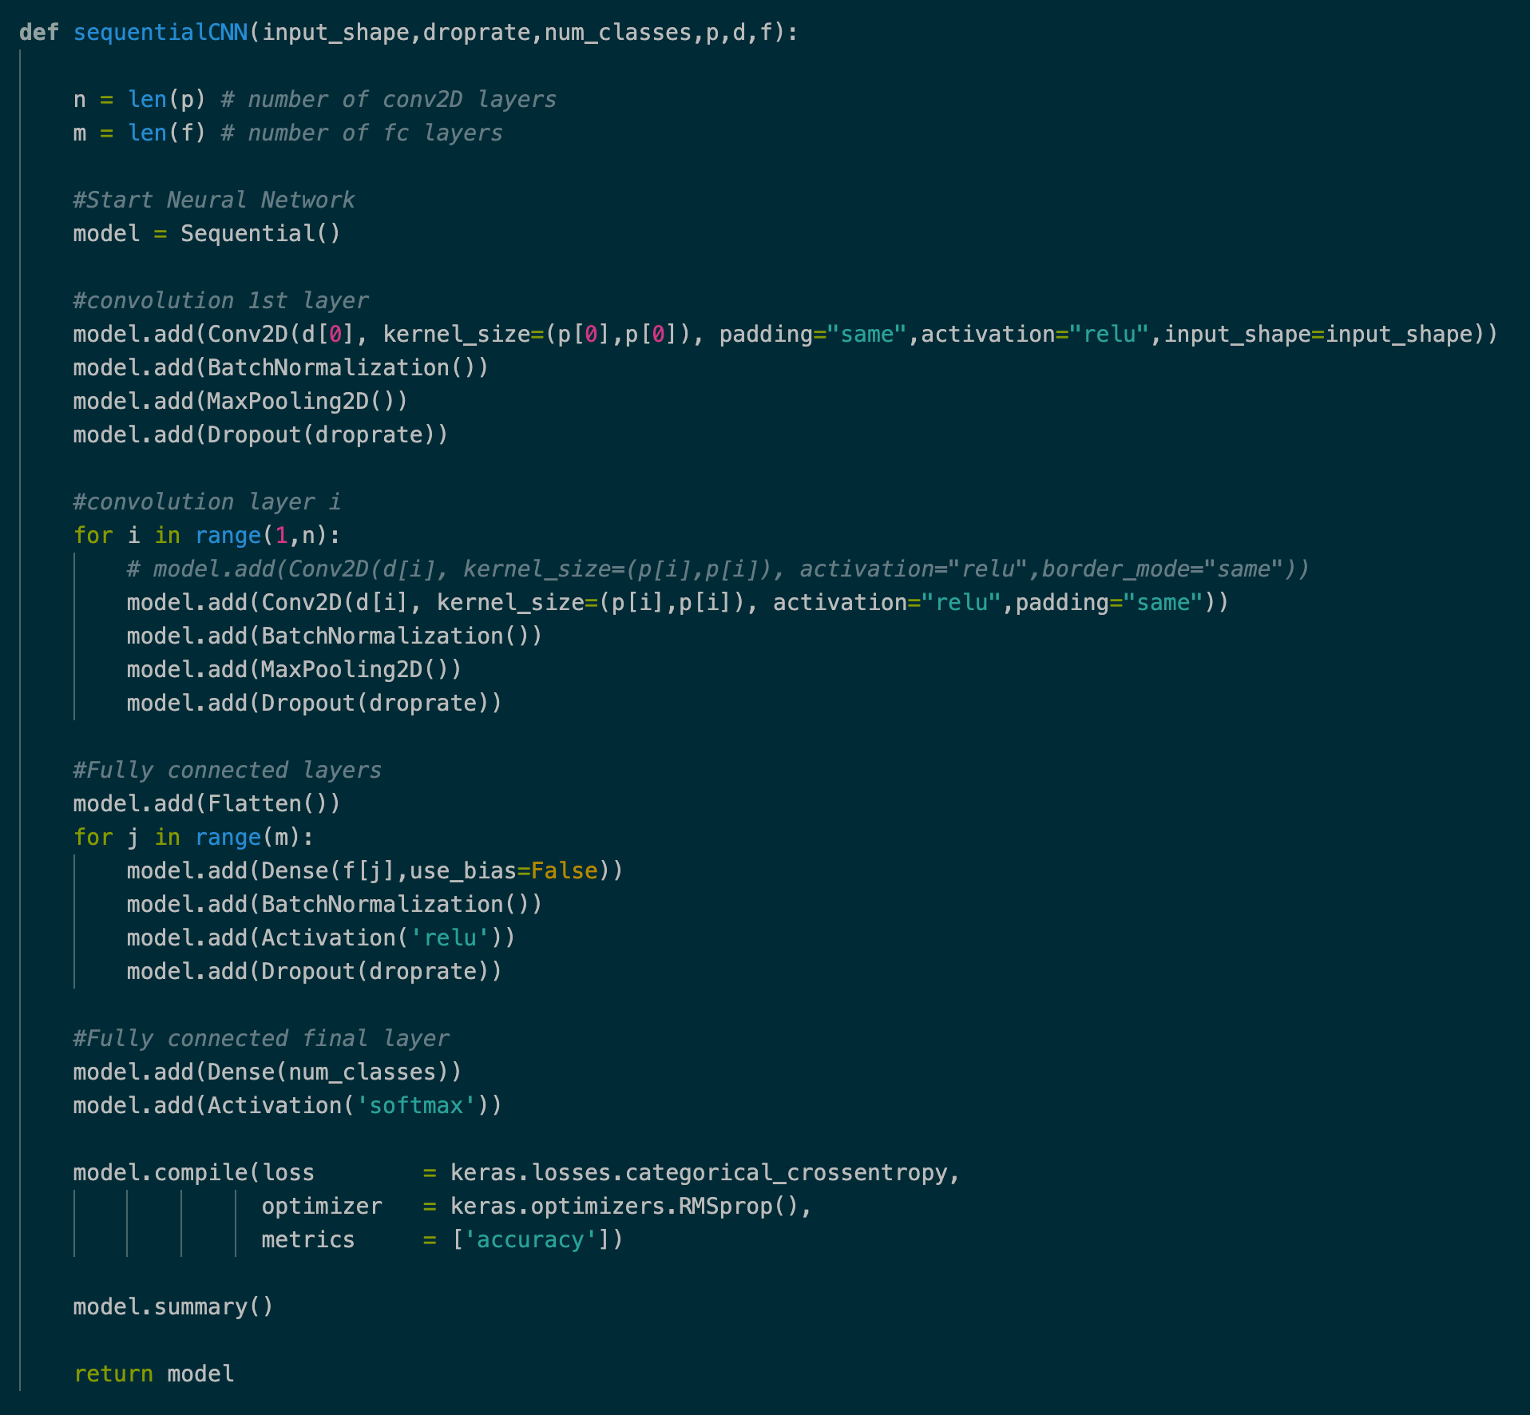
PAT04_DeepLearning.pptx

Slide 42
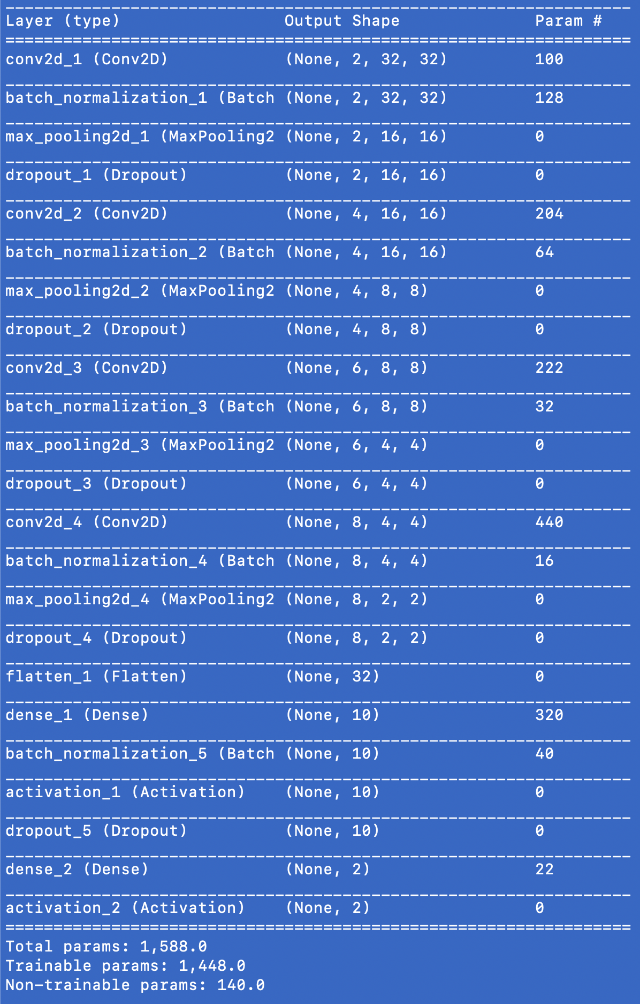
PAT04_DeepLearning.pptx

Slide 43
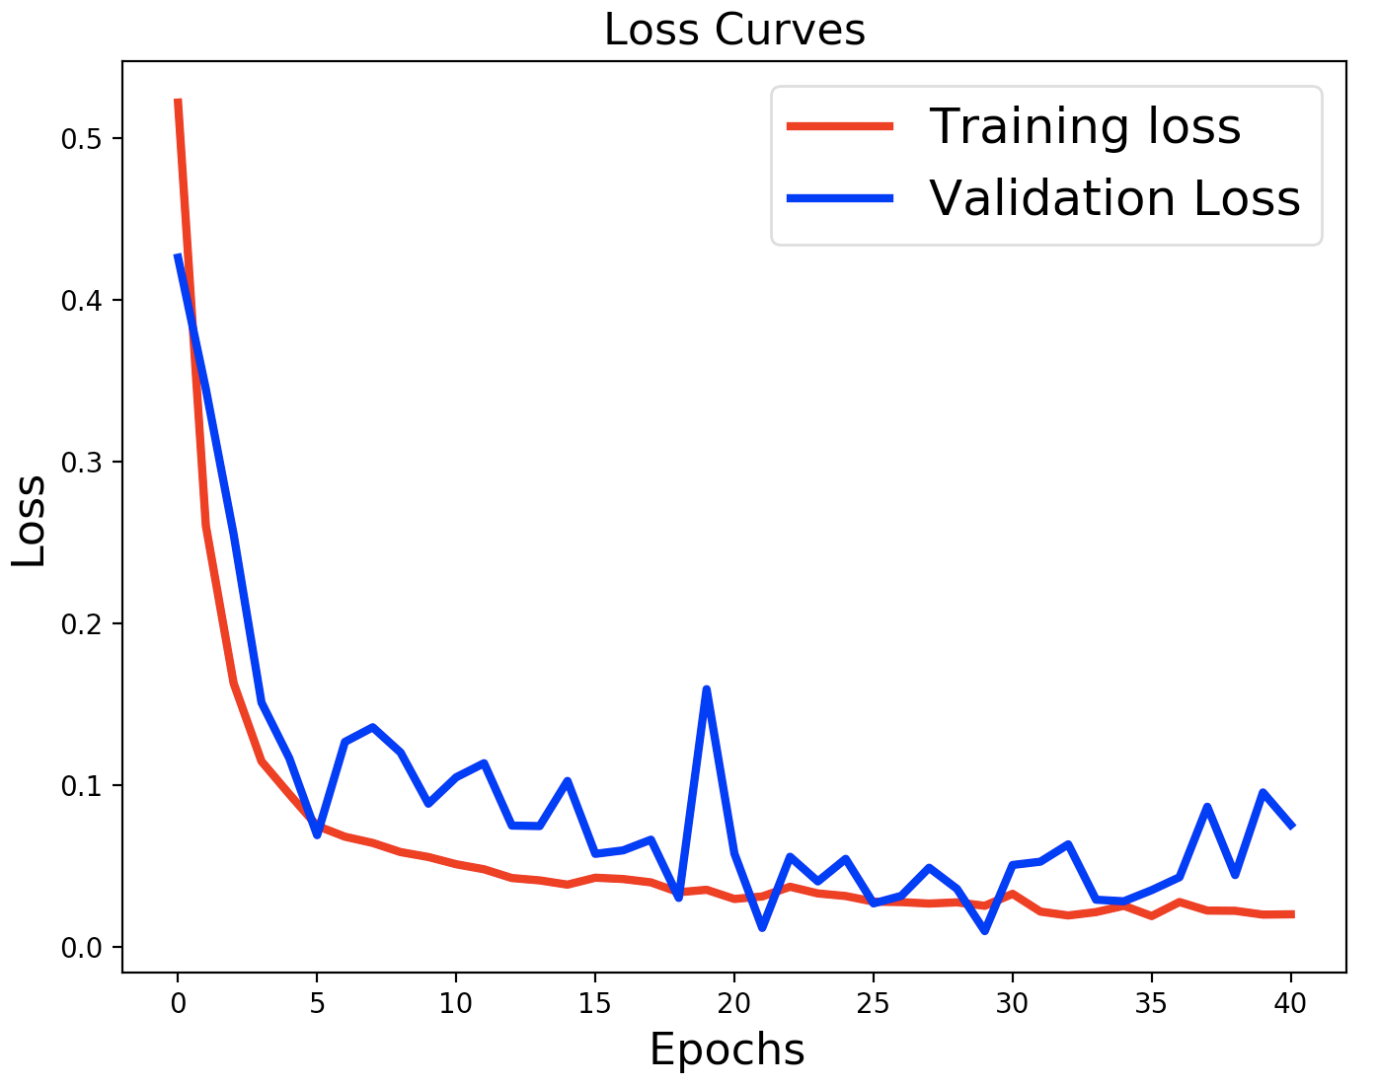
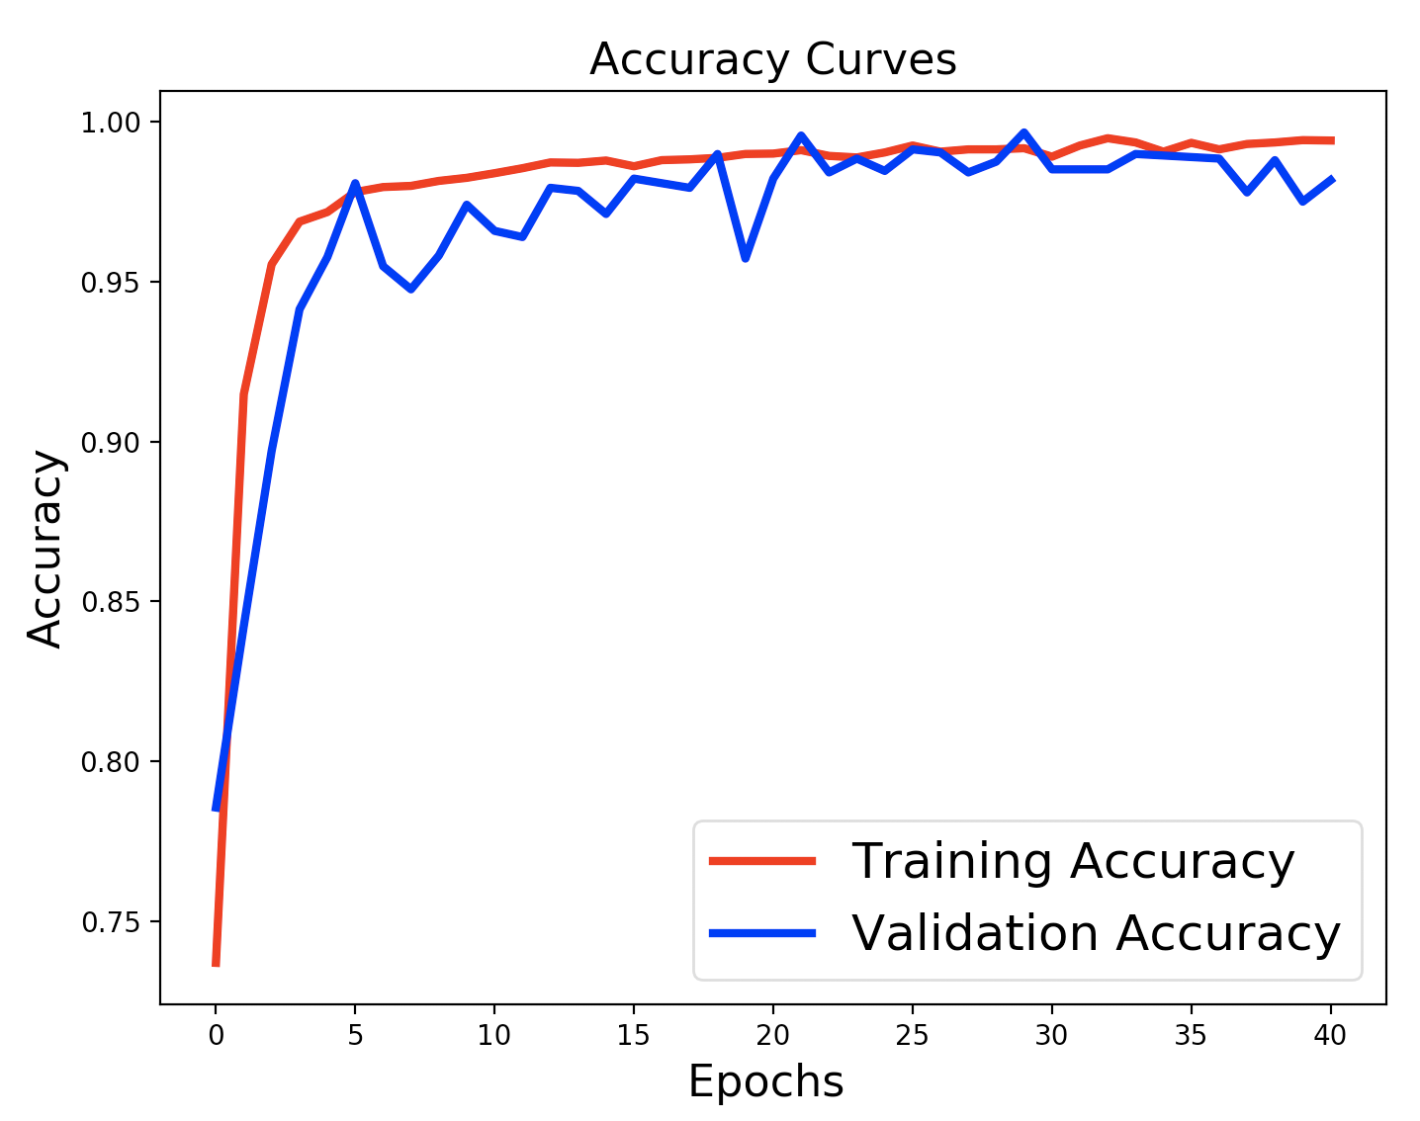
PAT04_DeepLearning.pptx

Slide 44
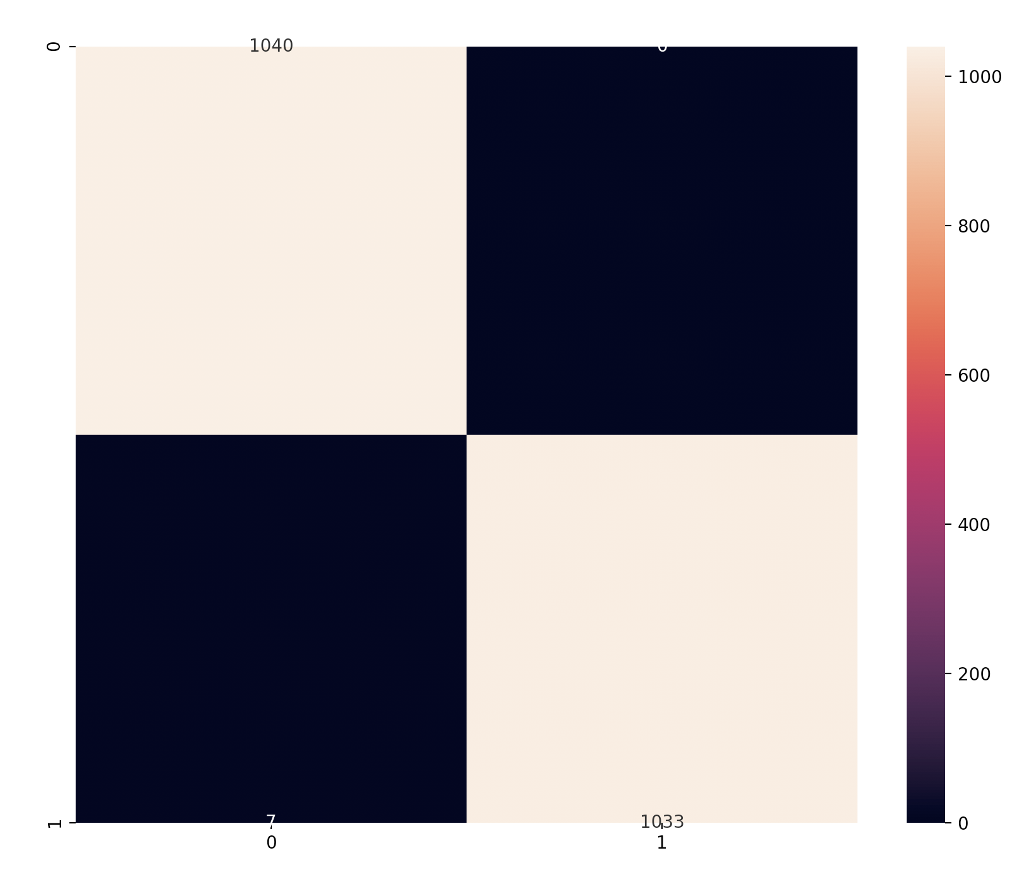
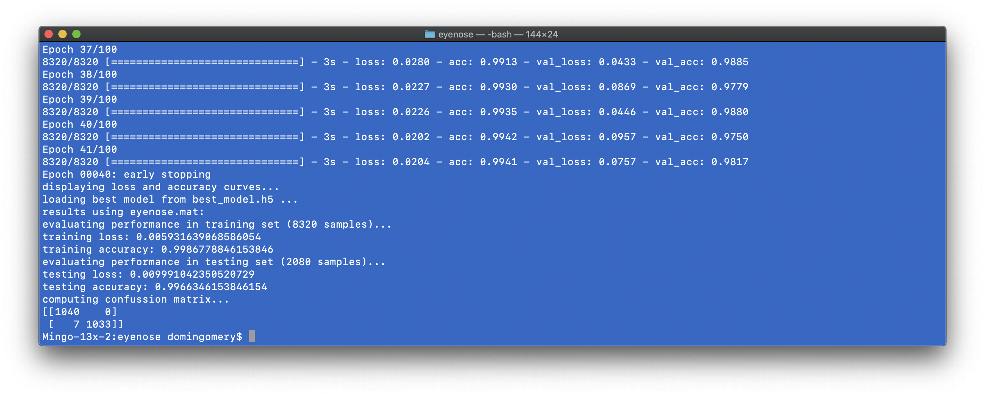
1040
0
Acc = 99.66%
7
1033
PAT04_DeepLearning.pptx

Slide 45
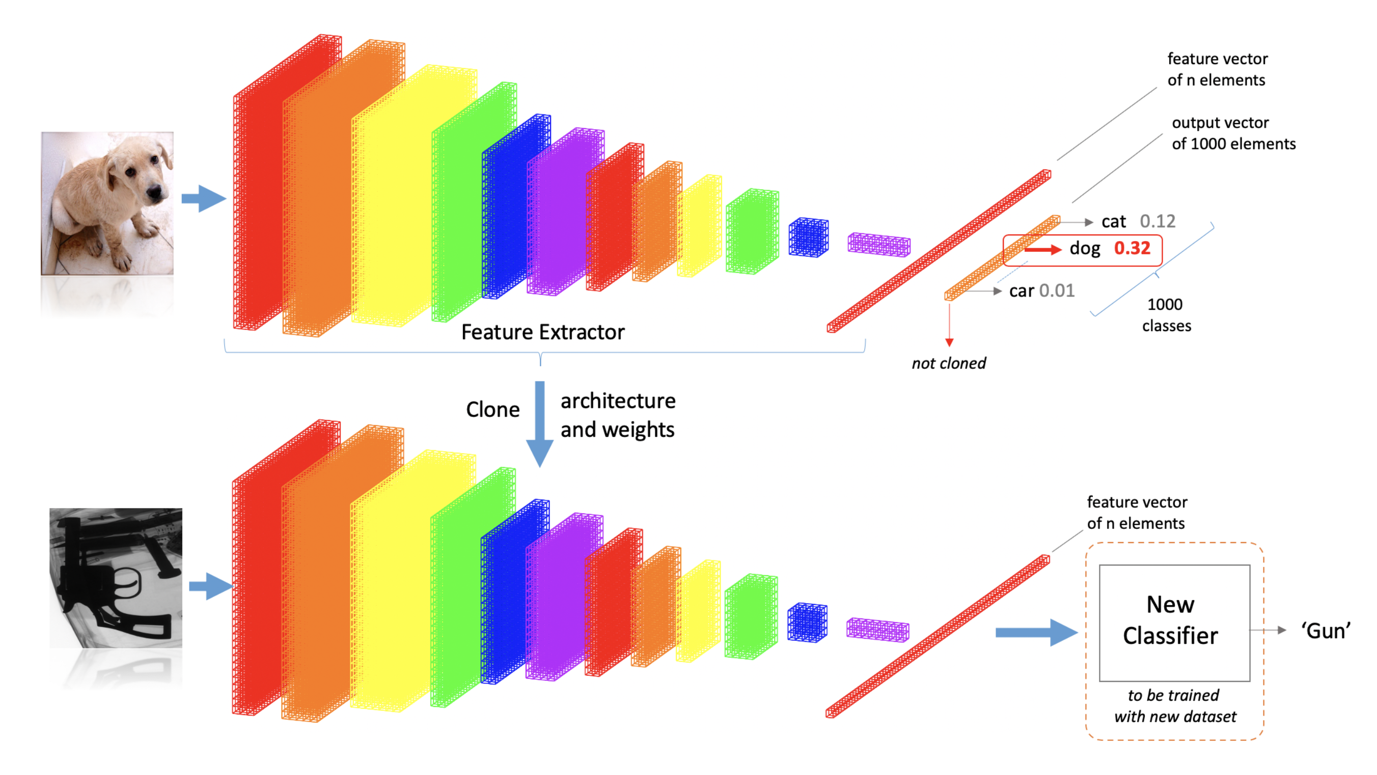
Pre-Trained Models
PAT04_DeepLearning.pptx

Slide 46
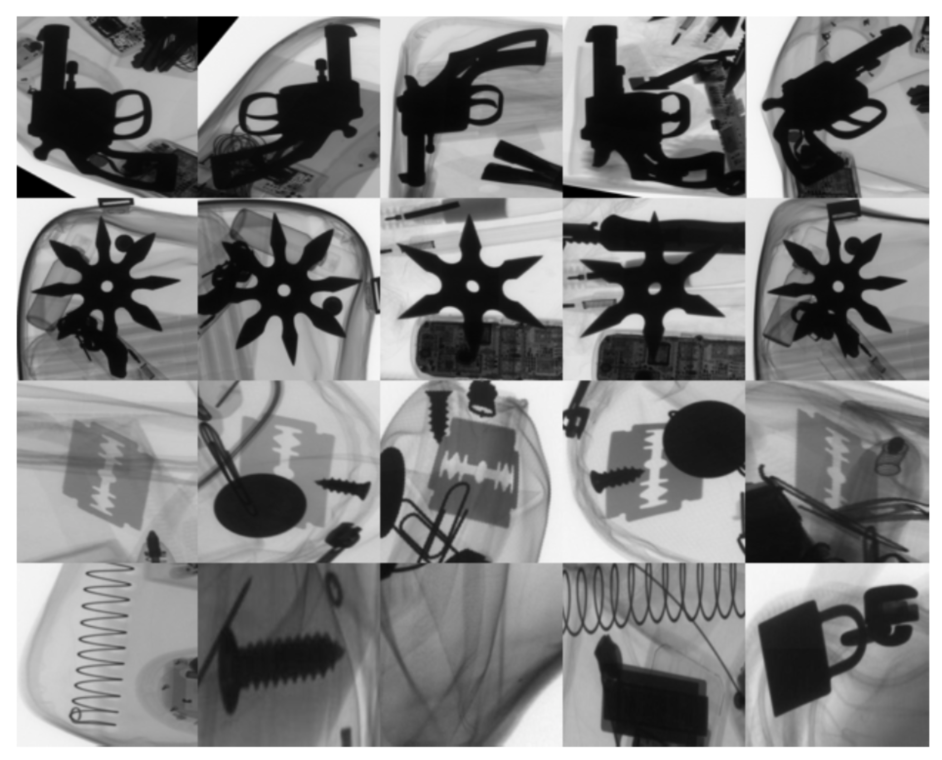

Slide 47
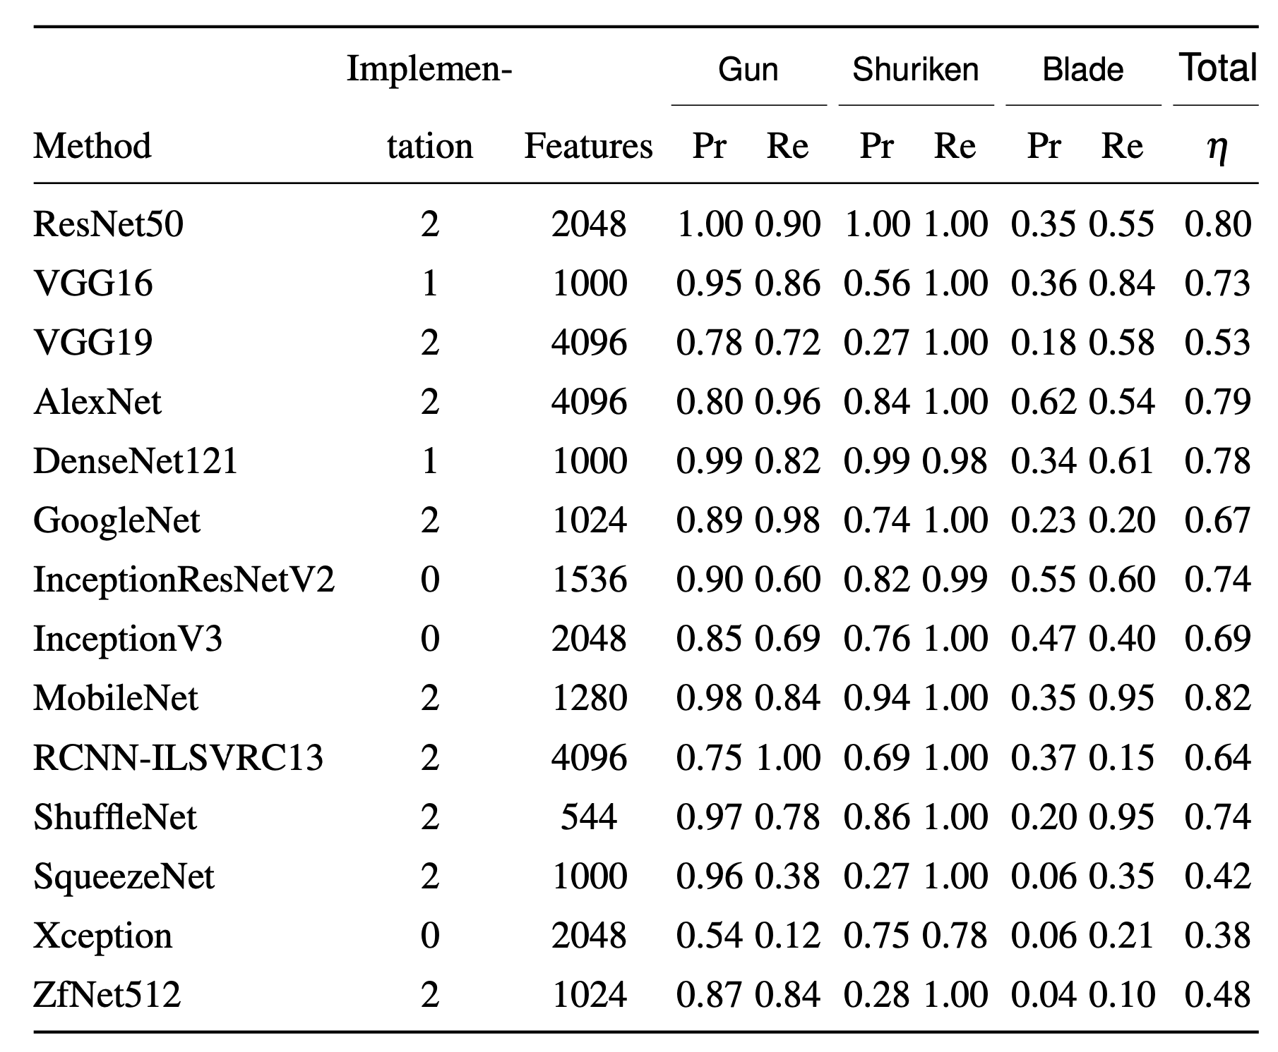

Slide 48
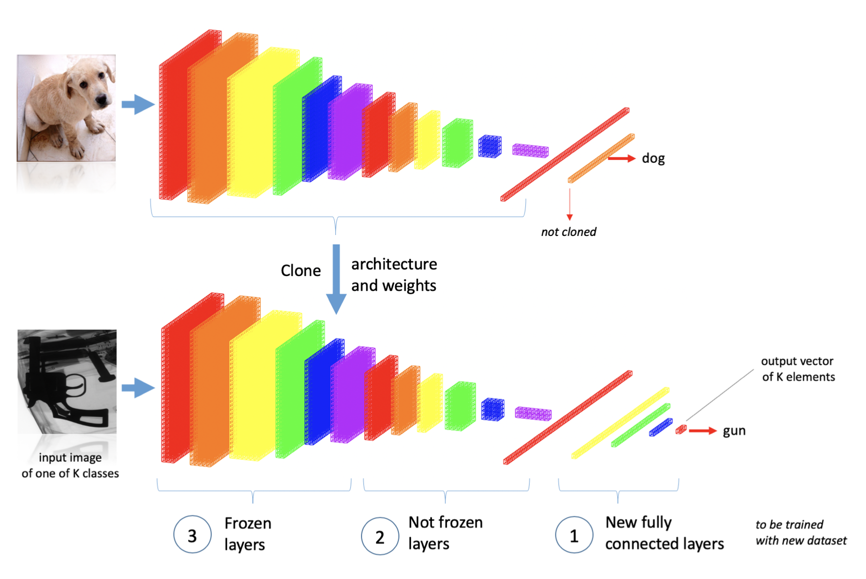
Transfer Learning

Slide 49
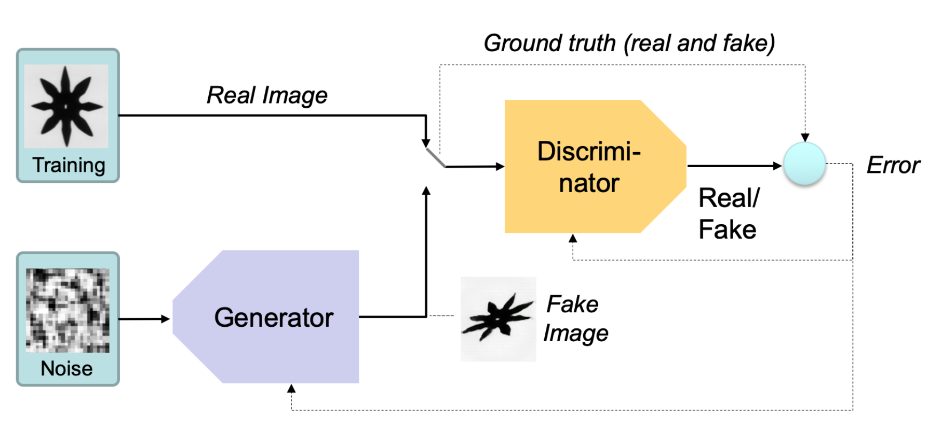
GAN: Generative Adversarial Networks
PAT04_DeepLearning.pptx

Slide 50
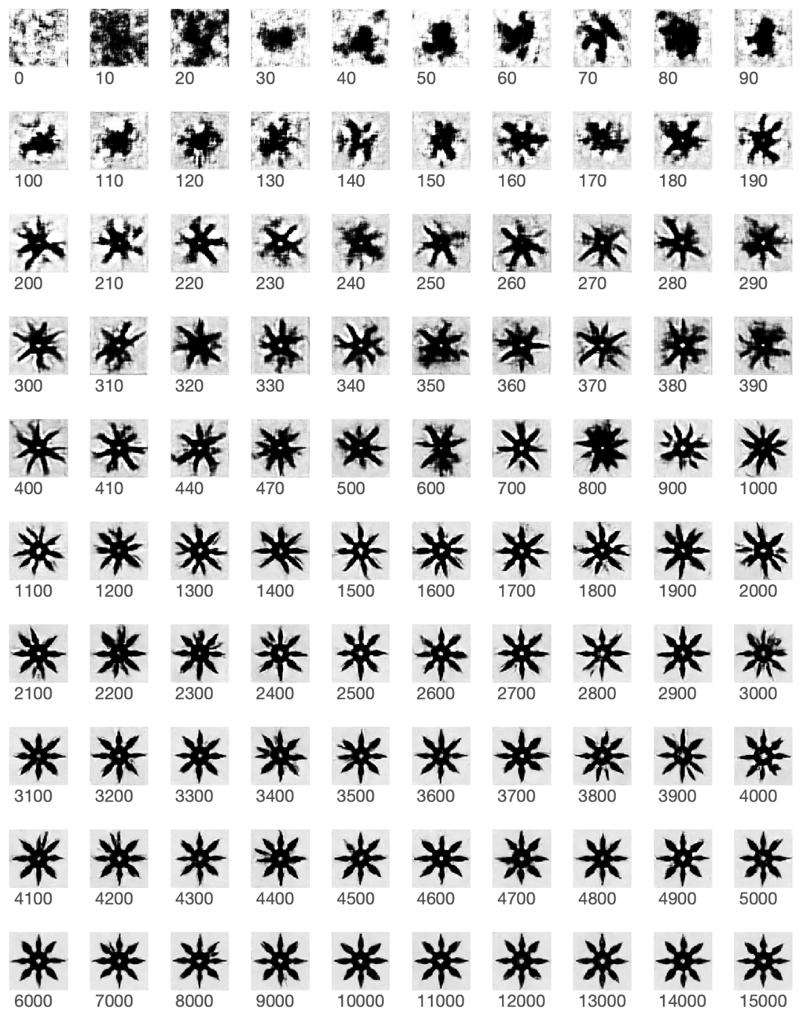
GAN: Shuriken

Slide 51
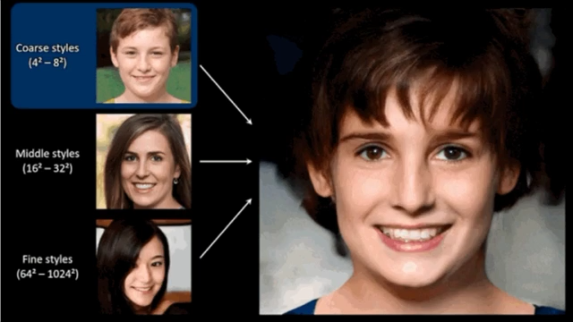
GAN: Generative Adversarial Networks
https://syncedreview.com/2019/02/09/nvidia-open-sources-hyper-realistic-face-generator-stylegan/

Slide 52
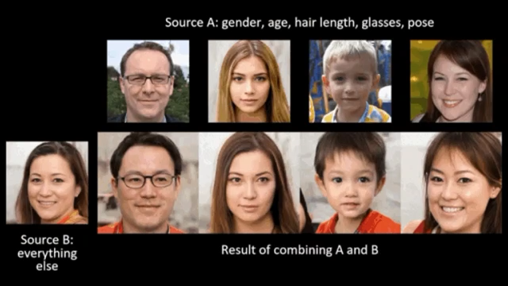
GAN: Generative Adversarial Networks
https://syncedreview.com/2019/02/09/nvidia-open-sources-hyper-realistic-face-generator-stylegan/

Slide 53
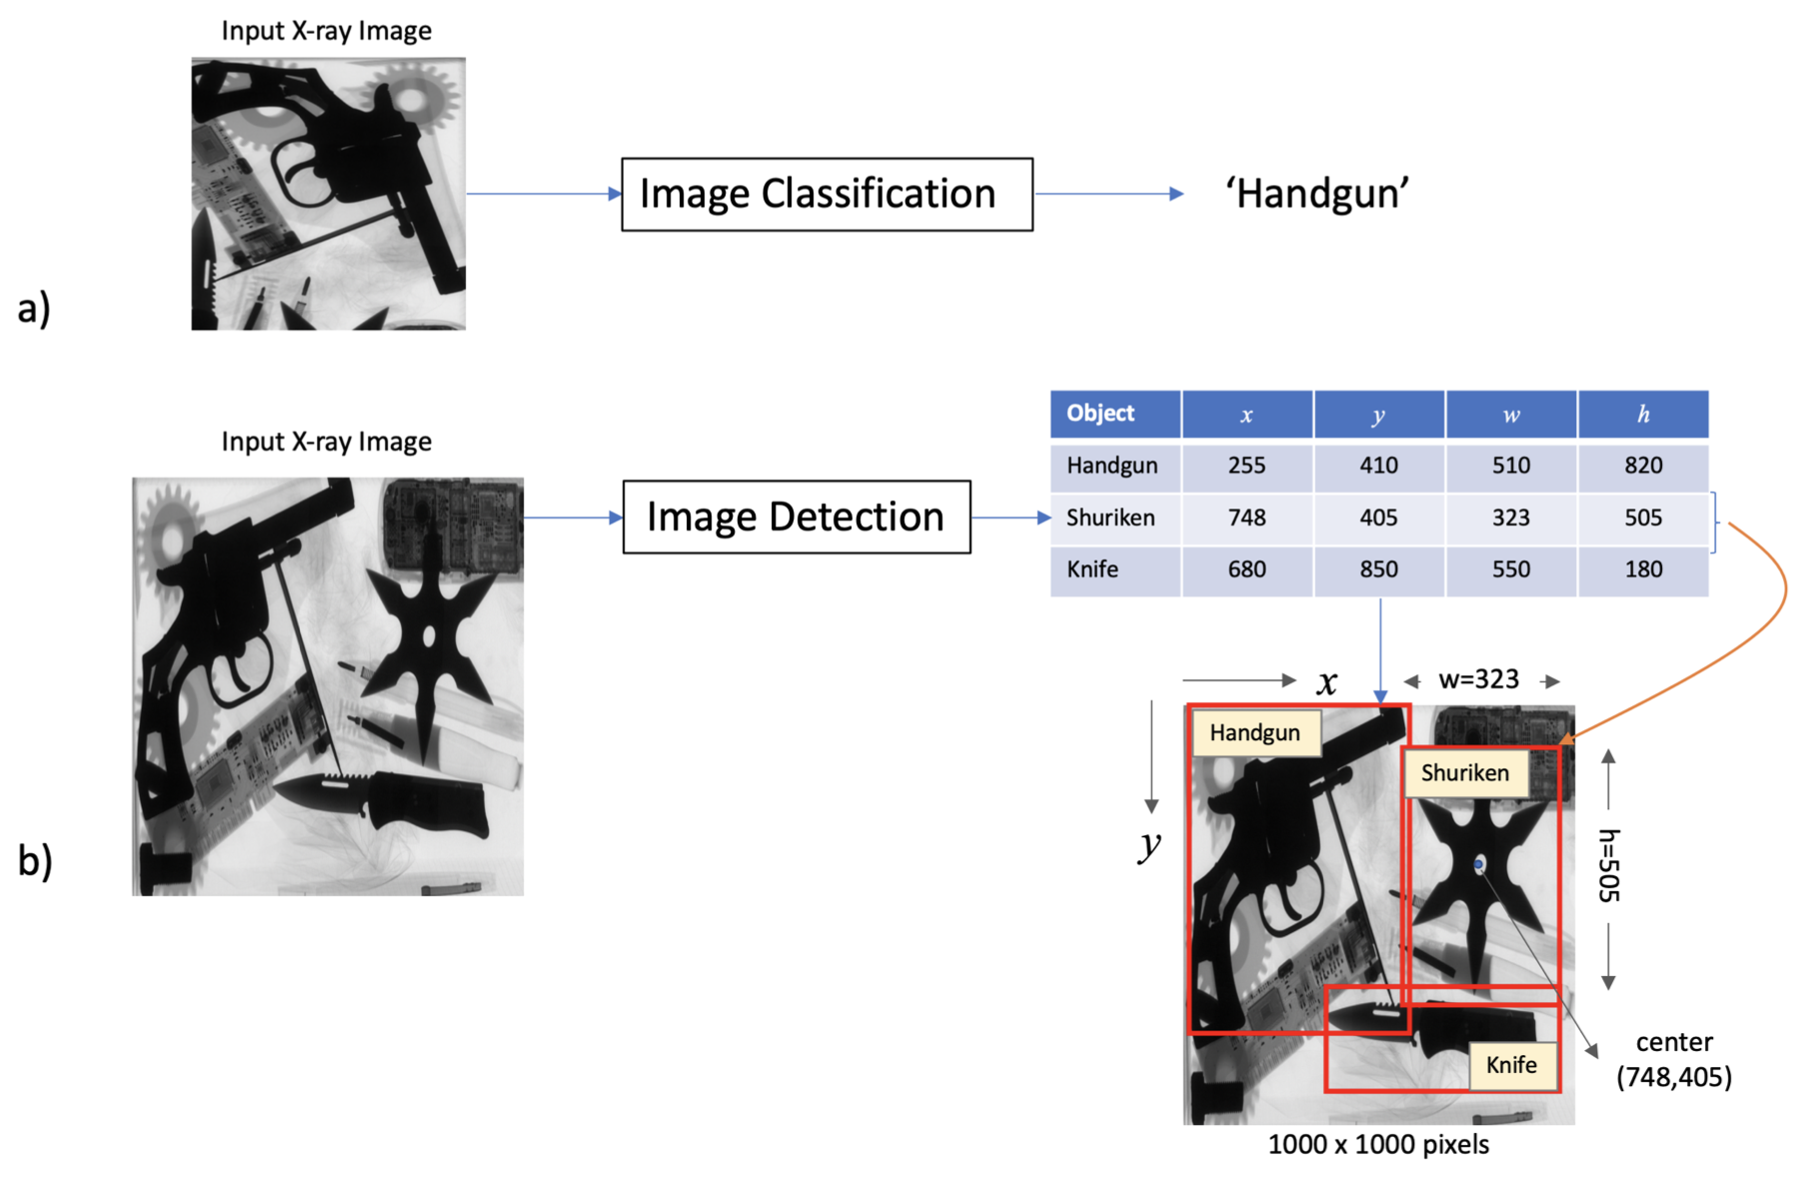
Image Classification vs. Image Detection
PAT04_DeepLearning.pptx

Slide 54
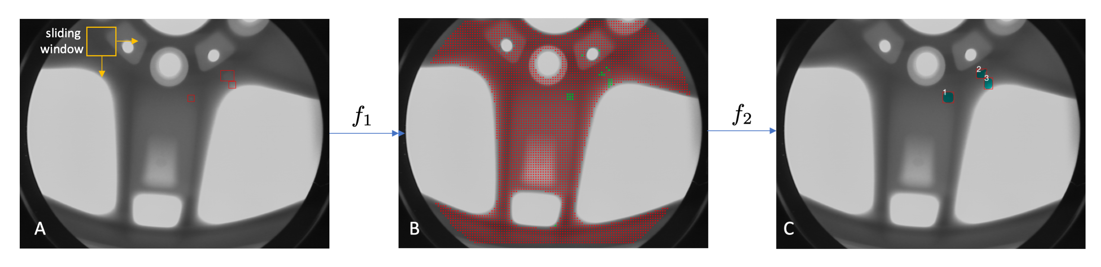
Image Detection: Sliding Windows
PAT04_DeepLearning.pptx

Slide 55
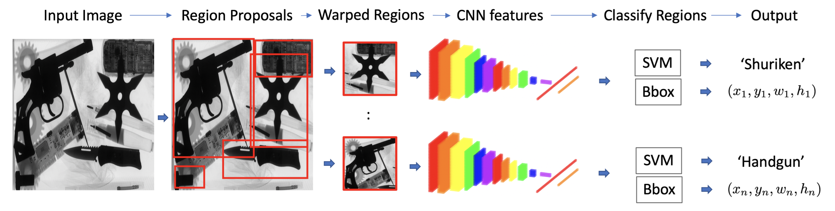
Image Detection: R-CNN
PAT04_DeepLearning.pptx

Slide 56
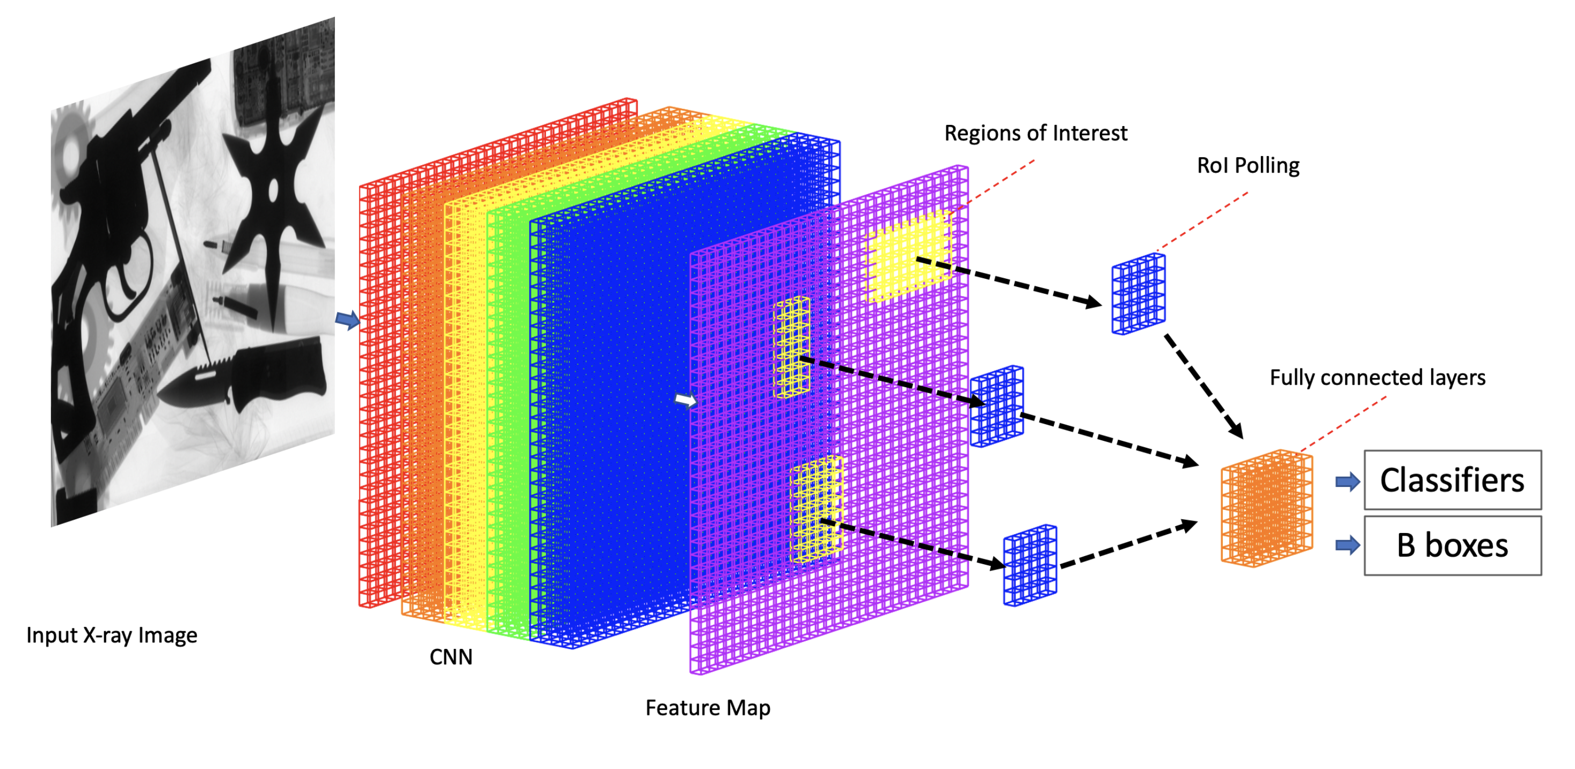
Image Detection: Fast R-CNN
PAT04_DeepLearning.pptx

Slide 57

Image Detection: Faster R-CNN and Mask R-CNN
PAT04_DeepLearning.pptx

Slide 58

Image Detection: YOLO
PAT04_DeepLearning.pptx

Slide 59


Slide 60


